Slide 1
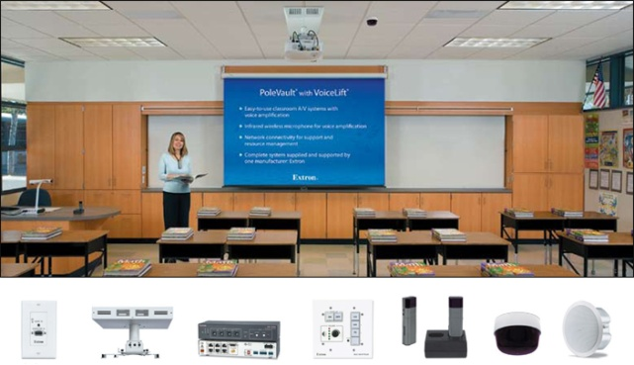
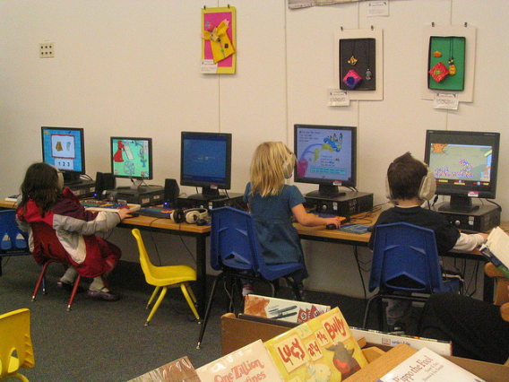
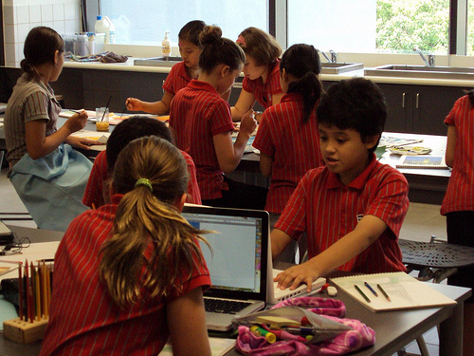
Managing the Media-Rich Classroom Meeting the Challenge of Delivering 21st Century Learning Dr. Susan Belgrad

Slide 2
Balancing the potential of each of the emerging technology/communication tools with the human capacities, needs and dispositions of students is a huge challenge to educators.
By using the principles of cooperative learning, team building, class building and positive discipline, it is possible to successfully transform schools and classrooms from the individual competition and solo performance behaviors of the "school as a factory" to the school as a "community of learners."

Slide 3
In the Media-Rich Engaged Learning Classroom:
1. Learning tasks are . . . 2. Assessment is . . . 3. Achievement of learning standards occurs because . . . 4. Heterogeneous grouping promotes . . . 5. Teacher roles are dimensional ranging from . . . 6. Student roles are dynamic and range from. . . | challenging and authentic. performance-based and an ongoing part of instruction. the learner is responsible for his/her own learning. Also, the learner collaborates with others. different ability levels and backgrounds of students to characterize learning. Explicit instruction of facilitator, guide and co-learner to the role of the teacher as an explorer who helps students construct their own knowledge and perspectives. active listener to producer and teacher, as students explore new ideas, share and construct knowledge and perspectives .

Slide 4
In the Engaged Learning Classroom Students Acquire Skill in Applying:
1. Abstraction 2. Systems Thinking 3 Experimentation 4. Communication and Collaboration Reich, R. (1992). The Work of Nations. | Taking apart challenging, authentic tasks or information and constructing deep understanding Understanding the responsibility for his/her own learning and participating in a learning environment that productively supports the success and achievement of other students. Seeing the problem and identifying ways to solve it; creating hypotheses and then organizing thinking to devise ways to test them. Active participation as both a receptive partner and a producer of ideas and decisions to share and construct knowledge and perspectives that may result in creativity and innovation--new ideas, products or performances.

Slide 5
In the Engaged Learning Classroom Students Acquire Skill in Applying:
5. Creativity and Innovation 6. Information, Media and Technology Skills 7. Life and Career Skills 8. Collaboration | Open-ended and problem-based tasks in lessons that blend media and technology with thinking outside the box; students see themselves as capable inventors, authors, problem solvers and designers ; Media and technology tools are classroom-based and accessible to students for authentic and responsible exchanges of media messages and engagement in understanding the ethical/legal issues surrounding the access and use of media; Students learn to be responsible to others through engagement in multi-dimensional lessons that promote flexibility in thinking, initiative and self direction; Positive interdependence and accountability is promoted in media-rich lessons that improve and maximize team creative efforts, exercise learner respect for the talents and perspective of diverse team members.

Slide 6
This picture paints a thousand words

Slide 7
And so does this one . . .

Slide 8
What’s wrong with this picture?

Slide 9
Web 2.0 and Beyond
Classroom 2.0 Beginner G…
1004 members
Elementary School 2.0
965 members
Mac Classroom 2.0
659 members
Professional Development
550 members
Distance Collaborations
545 members
DigiSkills
530 members
Free & Open Source Softw…
496 members
Connecting Content and T…
494 members
Google Apps for Education
486 members
Second Life
353 members

Slide 10
Strategic Plan for Managing Student Learning in the Media-Rich Classroom
Acquire the tools and strategies that engage students in creating a community of learners
Engage students in designing and monitoring the classroom technology rules that will guide their cyber-learning at the beginning of the year.
Learn how to create and manage cooperative learning base groups, informal and formal task groups to promote positive interdependence, individual accountability, equal participation and simultaneous interaction. Kagan, S.

Slide 11
Strategic Plan for Managing Student Learning in the Media-Rich Classroom
The Physical Setting
Thoughtfully plan the relationship between the print-based and media-based equipment and supplies of the classroom.
Consider the placement of visual-media displays so it does not compete with or overpower the print displays
Determine the illumination quality of the classroom so that displays are easily read by students from each desk location.

Slide 12
Strategic Plan for Managing the Media-Rich Classroom
Make careful decisions of how to design the Digital Classroom Environment
Planning classroom displays—whiteboards, interactive media boards, bulletin boards.
Managing displays
Focusing attention

Slide 13
Strategic Plan for Managing the Media-Rich Classroom
Considering learner roles and activities when planning classroom seating arrangement
Avoiding problems related to student attention when adding media and technology to the print-based classroom.
Focus Forward
Focus Fours
Problems can occur when we ADD media and digital support to the classroom instead of BLENDING it.

Slide 14
The key component for me is connecting students, both face to face and virtually, from a variety of backgrounds to work together to solve a common problem. Although we might not have the luxury of bringing together diverse groups of students every day, we certainly have the capability to connect them using technology. No matter what subject you teach, I truly believe adding a global component is not only possible, but necessary to prepare students for our increasingly connected world. Kim Cofino

Slide 15
The “Smart” Classroom
Notes:
Instead of a textbook driven curriculum the focus is more research driven where the students are actively learning, participating in the process. Gone are the 4 walls of the classroom. Students and teachers alike work collaboratively not just with those in the physical classroom but with other students and teachers around the world creating the Global Classroom. Classes are now student centered with the teacher as the facilitator which allows the students more freedom to learn at their own pace. With teachers and students now co-learners, student participation and motivation is increased which leads to fewer discipline problems.

Slide 17
Blogs in groups
Check out a Kindergarten Teacher’s
Classroom Blog
She uses Skype Pals to promote audio and visual

Slide 18
Blogs in groups
Check out a Kindergarten Teacher’s
Classroom Blog
She uses Skype Pals to promote audio and visual

Slide 19
Blogs in groups
Check out a Middle Grade Teacher’s
Classroom Blog
Edublogs Free is the perfect way to get your students blogging! Free Blog Features
Easily create posts & pages
Select from 30 free themes
Upload any type of files including docs, PDFs, slideshows, movies, and more
Enjoy 'User Friendly Blogging'
No email address required
Ready in under 20 seconds
For more features, storage and to turn of any advertising check out Edublogs Pro »
Ten Ways To Use Your Edublog

Slide 20
An Example of a Middle-Grade Blog Written as a Cooperative Group
Teacher leads a lesson on an example of social injustice-- 2. Teacher assigns cooperative learning groups roles, task and time limit. 3. Groups are given 20 minutes to create their episodes and illustrations. The students are asked for their feelings about the group reports. The teachers conducts a five-minute lesson on the actual story of author Margaret Rey . In their groups, students respond the blog question, “How can it be fair for women or anyone to have credit for their work taken away and given to someone else?” | She reads aloud the original Curious George storybook and cites the author as H. A. Rey, first published by Houghton Mifflin in 1941. Assigns groups that are composed of two girls and two boys. Once in cooperative groups the roles of checker, writer, illustrator and recorder are assigned. Each group is assigned the task of creating an episode of mischief for CG. When written and illustrated the groups present. But only the BOYS are represented in the presentation and only the BOYS are permitted to sign their names. Students are given the opportunity to “voice” their feelings about being treated inequitably. After their harrowing escape from Paris in World War II, Margaret and husband, H.A. Reyes had to wait until 1940 to presneter her manuscript—the publisher would not produce it in her name! Media and technology tools are classroom-based and accessible to students for authentic and responsible exchanges of media messages and engagement in understanding the ethical/legal issues surrounding the access and use of media

