Slide 1

Additional Pay System
Sponsored Programs Resource Fair
Presented by:
Carmen Lichtscheidl, Office of Faculty Affairs
Grace Slavik, The University Corporation
October 10, 2017

Slide 2
Additional Employment Policy
Per the Faculty Collective Bargaining Agreement (CBA) and the CSU System-Wide Additional Employment Policy (HR 2002-05), the limit of total workload is 125% (25% overage of full-time time base).
Additional Employment Availability
Fall 2017: 21 days total (25%)
Spring 2018: 22 days total (25%)
The number of days available each semester is the total across all areas (State, ExL, TUC) combined.

Slide 3
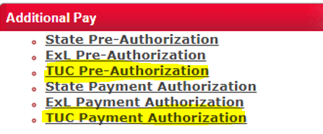
Additional Pay System
Enables us to track additional employment across all areas (State, TUC, ExL)
Accessible through the MyNorthridge Portal
Two-step process
  Pre-Authorization of work
  Payment Authorization

Slide 4
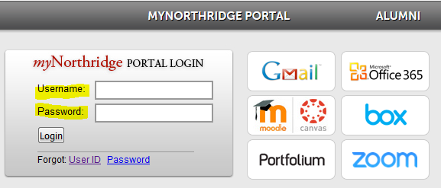
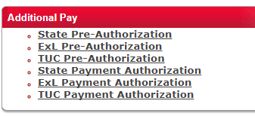
Additional Pay System
How to Access
Go to www.csun.edu and locate the MyNorthridge Portal login window. Once located, proceed by logging in.
Once logged in, locate the Additional Pay pagelet and select the appropriate option to proceed.

Slide 5
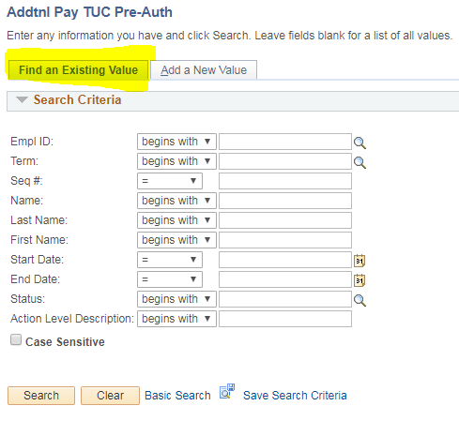
Additional Pay System
How to Access
When in the TUC Pre-Authorization window, there will be two options: Find an Existing Value and Add a New Value.
Use Find an Existing Value when searching for a request that requires your approval, or to find out the approval status of a request.
Pro Tip: To search for all pending requests, simply hit the “search” button at the bottom of the page. If looking for an individual request, enter the Employee ID number or the individual’s name. You do not have to complete all the fields in this section.

Slide 6
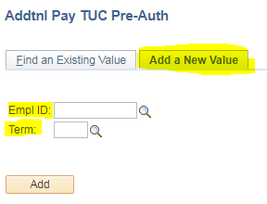
Additional Pay System
How to Access
Use Add a New Value when entering a brand new request.
Simply enter the Employee ID number of the individual who will be receiving the payment, along with the term that the payment is for.
Pro Tip: If you do not know the Employee ID number of the individual the request is for, click on the magnifying glass and enter the individual’s name. This will pull up that person’s ID number. Same process should be followed for the Term.

Slide 7
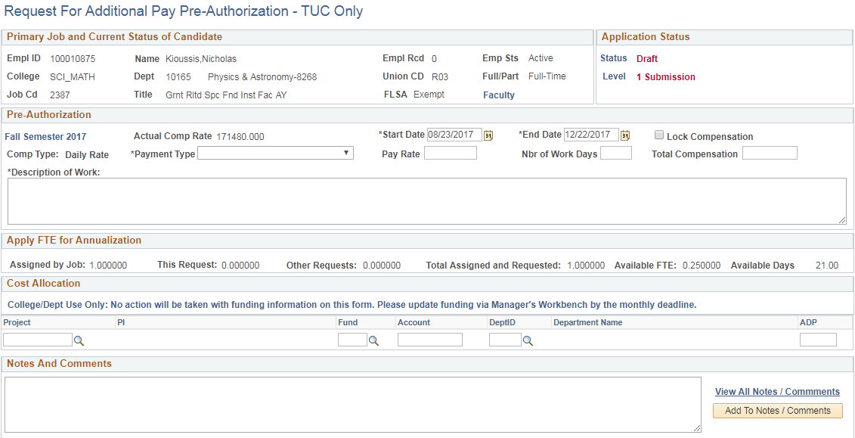
Additional Pay System
Entering a Request
Employee’s primary job information
Information for this request
Time available for additional work
Grant information

Slide 8
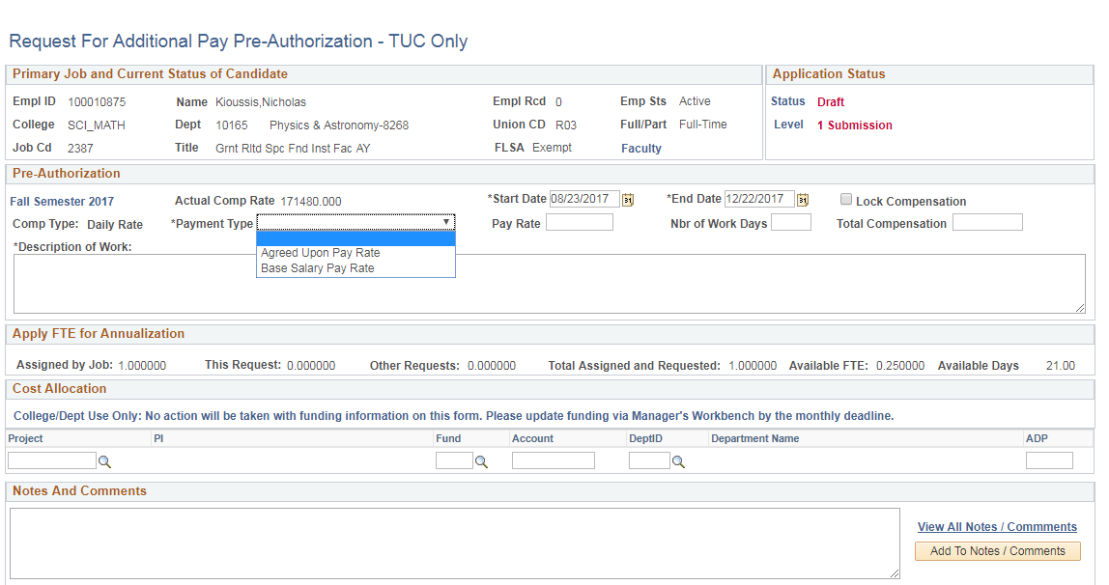
Additional Pay System
Entering a Request
If your grant requires that you be paid out using your base salary pay rate, be sure to select this option under the Payment Type dropdown.

Slide 9
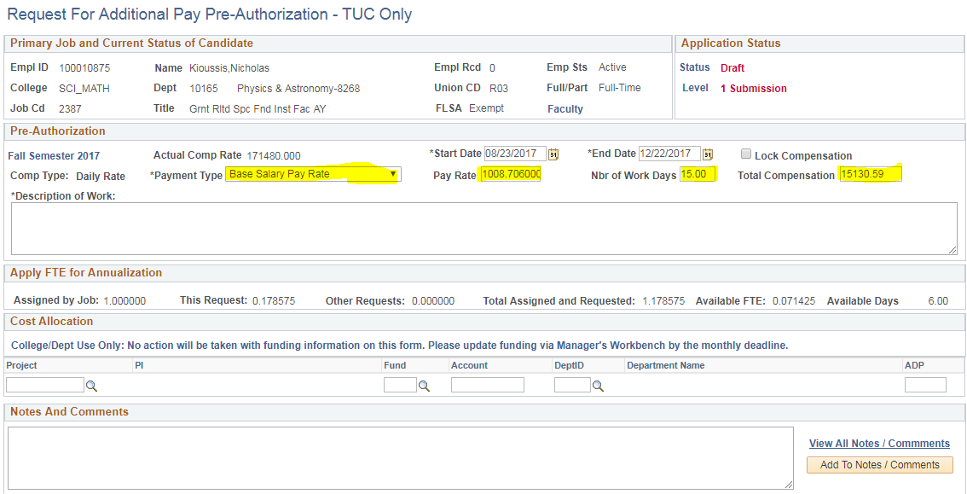
Additional Pay System
Entering a Request
Once the Base Salary Pay Rate has been calculated, you may choose how many days of work need to be used to work on your project. This will automatically calculate the Total Compensation for you.

Slide 10
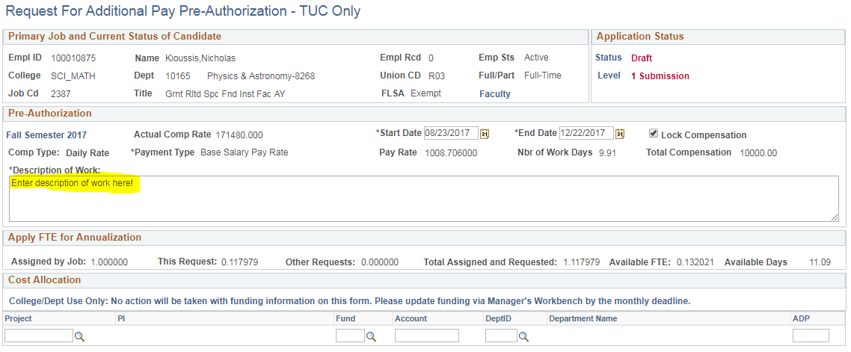
Additional Pay System
Entering a Request
Be sure to enter a brief, but thorough description of work in the Description of Work section, and be sure to enter the correct and actual information for your grant.

Slide 11
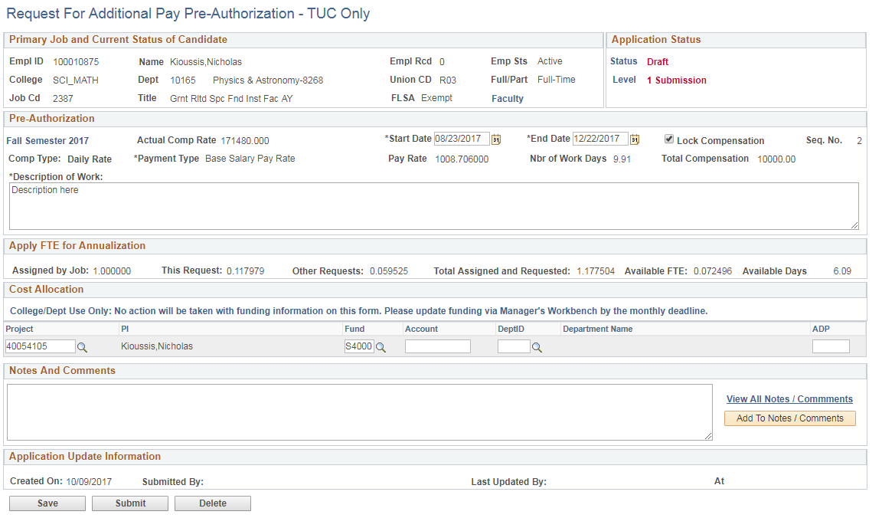
Additional Pay System
Submitting a Request
Once the request has been completed, you may either Save the request, or Submit it by clicking on the appropriate button at the bottom of the page.

Slide 12
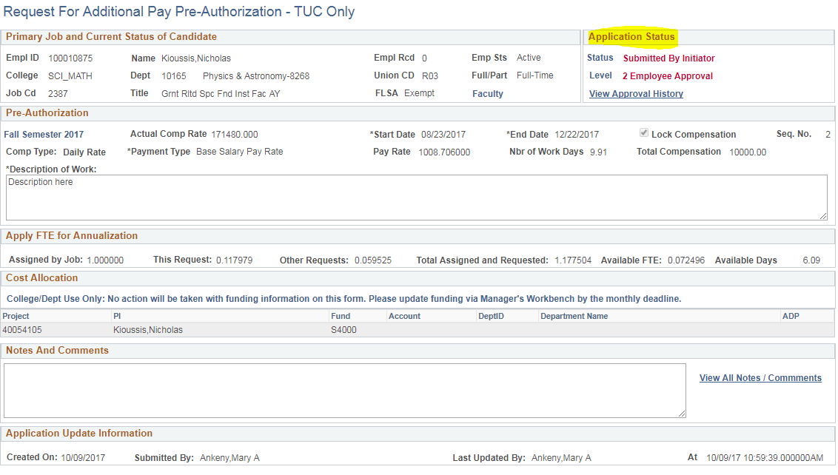
Additional Pay System
Submitting a Request
Once request has been submitted, the status of the request can be viewed at the top right of the page.

Slide 13
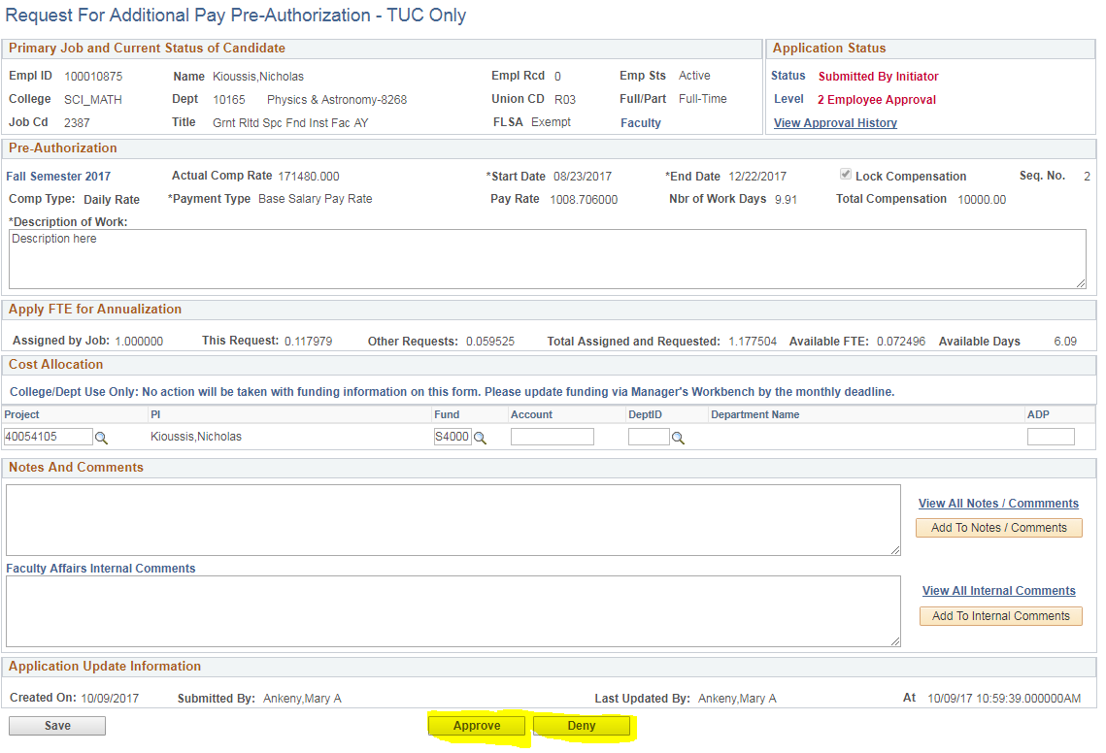
Additional Pay System
Approving a Request
The next person in the approval path will receive an automated message letting them know that a request is pending their approval. Follow the same steps as before to access the request, and once there, you can either Approve or Deny the request at the bottom of the page.

Slide 14
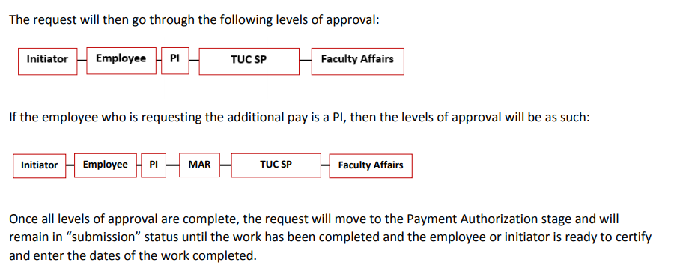
Additional Pay System
TUC Approvals

Slide 15
Questions & Information
For policy and training guides, please visit the Additional Pay website: http://www.csun.edu/faculty-affairs/additionalpay
For questions and inquiries related to the Additional Pay system, please contact additional.pay@csun.edu

