Slide 1
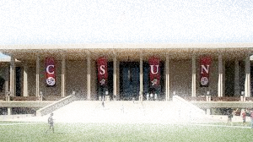
Risk & Insurance Careers Rising Risk Professionals –LA RIMS (Los Angeles Chapter of the Risk & Insurance Management Society)
3/2/2018

Slide 2
Notes:
Stories of Encountering

Slide 3
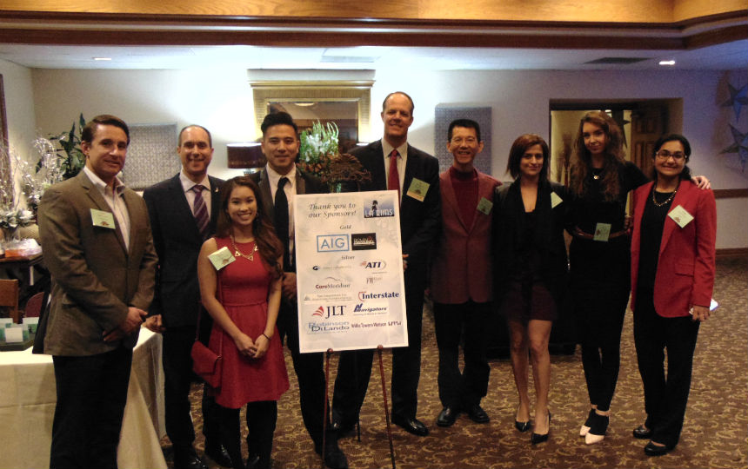
LA RIMS Holiday Party (12/6/2016)

Slide 4
Mary Daly
Principal
FCAS, MAAA
Steve Dubiel
Energy & Const.
Practice Leader
MBA, CRIS
Margaret Fisette
Senior Risk Analyst
CPCU, CIC, ARM, CRM, MBA
Patrick Novack
Senior Risk Analyst
ARM, RIMS-Certified Risk Management Pro
◾
Taylor Turney
Director – LA
Chair of the RRPs
Notes:
Two Beautiful Minds

