Slide 1
PIF Workshop College of Humanities April 19, 2012
Ian Barnard, English
Tim Black, Philosophy
Yreina Cervantez, Chicano/a Studies

Slide 2
Before Construction Begins
Know the relevant policies
The university’s policies, as expressed in Sections 606 & 630-639 of the Administrative Manual
Your department’s policies, especially those concerning equivalencies to publication (including art, music, media, etc.)
Preparing to document your professional activities
What you should save
Enough documentation is enough

Slide 3
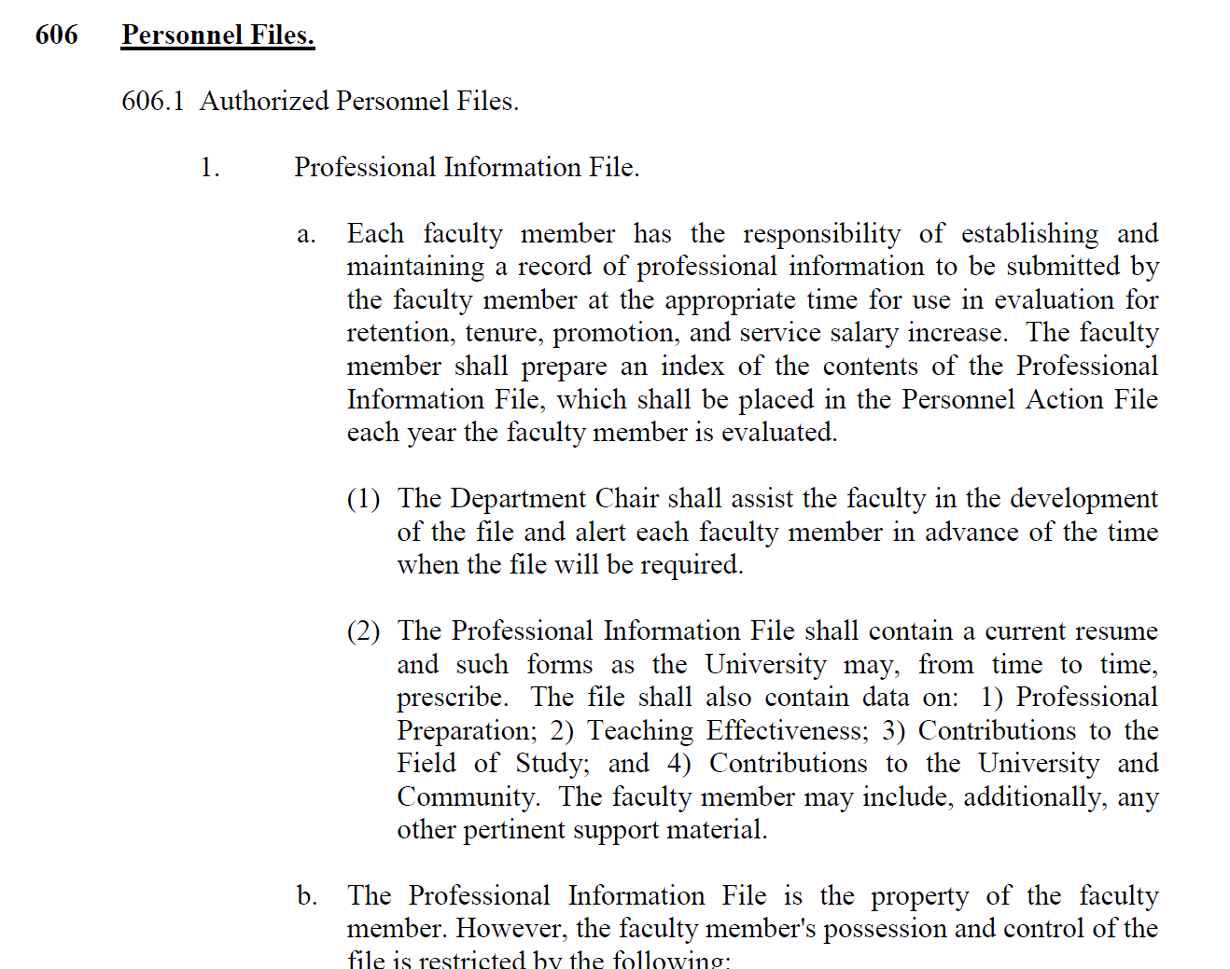
The University’s RTP Policies
Section 606 of the Administrative Manual http://www.csun.edu/facultyaffairs/policies/manuals/section600.pdf

Slide 4
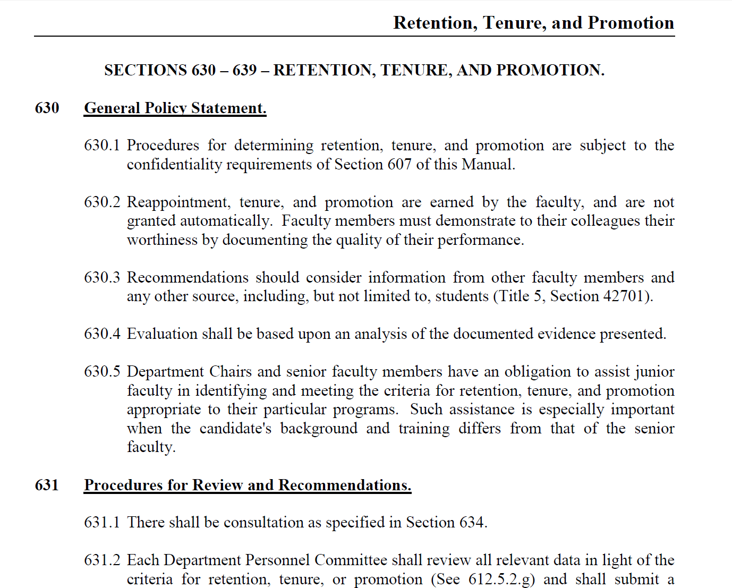
The University’s RTP Policies
Sections 630-639 of the Administrative Manual http://www.csun.edu/facultyaffairs/policies/manuals/section600.pdf

Slide 5
What Does Not Go Into Your PIF
The contents of your PAF (Personnel Action File), which is on file in the Dean’s office, should not be duplicated in your PIF. Your PAF includes permanent items maintained throughout your employment at CSUN, for example,
your hiring letter,
acceptance letter,
personnel review letters,
teaching evaluations,
etc.

Slide 6
What Does Go Into Your PIF
“Opening statement”
Index
Tells readers where in your PIF they can find certain documentation
Your CV
Section “overviews”
Documentation of your professional activities and accomplishments

Slide 7
Your CV
Revise your CV so that its structure mirrors the structure of Sections 632.2-5
1. Professional Preparation
2. Teaching Effectiveness and Direct Instructional
Contributions
3. Contributions to the Field of Study
4. Contributions to the University and Community

Slide 8
Your CV
Once your CV’s structure mirrors that of Sections 632.2-5, you should:
Revise and reorganize your CV so that each item on it falls under the appropriate heading
Decide where on your CV (i.e. under which heading) to put certain items
Arrange for your PIF’s structure to mirror that of your CV
Use the Index as an intermediary between your CV and your PIF
Where an item appears on your CV serves as a guide to where it (or documentation of it) will appear in your PIF

Slide 9
From CV to Index
→

Slide 10
“Opening Statement”

Slide 11
Index

Slide 12
Section “Overview”

Slide 13
Helpful Hints
Saving space by
Copying efficiently
Avoiding duplication
Practicing the “enough-documentation-is-enough” rule
Ensuring readability by
Having someone read and review your PIF before you submit it
Double-checking your PIF’s organization, the accuracy of your Table of Contents, the comprehensiveness of your documentation, and so on

