Slide 1
Comprehensive Analysis of the Impact of Change of Major in CECS on Graduation Rates
Maryam Tabibzadeh, PhD
Department of Manufacturing Systems Engineering & Management
College of Engineering and Computer Science

Slide 2
Guiding Questions
Does change of major lead to greater student success; e.g. higher rate of graduation?
Is the year of changing the major highly correlated with graduating earlier?
What are some key academic records/events that trigger the desire of students to change their major?
What are some recommendations to facilitate identifying and guiding struggling students to explore other majors?

Slide 3
Data Analysis & Observations
All Cohorts-ME | Number | % out of total | % out of graduated
Total # of admitted Students | 734
Graduated students in total | 375 | 51.09%
Graduated students from ME | 269 | 36.65% | 71.73%
Graduated students from another ECS major | 26 | 3.54% | 6.93%
Graduated Students from a non-ECS major | 80 | 10.90% | 21.33%
Not graduated | 359 | 48.91%
Available data for 3034 students who were admitted in an Engineering and Computer Science major:
Fall 2008-11; FTF & Fall 2011-13: FTT
Pathway data for each student
Graduation Rates for All Admitted ECS Majors
Number of Years to Graduate for ME FTF Students (Fall 2008-11 Cohorts)
Number of Years to Graduate for ME FTF Students – Fall 2011 Cohort
All Cohorts- Weighted Average for All ECS Majors | Percentage
Weighted average percentage of total graduated students | 50.11%
Weighted average percentage of graduated students from admitted major | 26.31%
Weighted average percentage of graduated students from another ECS major in the same Dept than admitted | 5.25%
Weighted average percentage of graduated students from another ECS major in a different Dept than admitted | 8.11%
Weighted average percentage of graduated students from a non-ECS major | 10.44%
Not graduated | 49.89%
All Cohorts-FTT-ME | Number | % out of total | % out of graduated
Total # of admitted Students | 403
Graduated students in total | 161 | 39.95%
Graduated students from ME | 80 | 19.85% | 49.69%
Graduated students from another ECS major | 13 | 3.23% | 8.07%
Graduated Students from a non-ECS major | 68 | 16.87% | 42.24%
Not graduated | 242 | 60.05%
Years to Graduation | 4 years | 5 years | 6 years | > 6 years | Total
Graduated from ME Major | 2.67% | 9.33% | 10.00% | 0.00% | 22.00%
Graduated from another ECS Major | 0.67% | 0.67% | 1.33% | 0.00% | 2.67%
Graduated from a non-ECS Major | 2.00% | 6.00% | 5.33% | 0.00% | 13.33%
Total | 5.33% | 16.00% | 16.67% | 0.00% | 38.00%
Years to Graduation | 4 years | 5 years | 6 years | > 6 years | Total
Graduated from ME | 0.99% | 2.48% | 14.14% | 2.23% | 19.85%
Graduated from non-ME | 1.24% | 2.48% | 13.90% | 2.48% | 20.10%
Total | 2.23% | 4.96% | 28.04% | 4.71% | 39.95%
All Cohorts-FTT-ME | Number | % out of total | % out of graduated
Total # of admitted Students | 331
Graduated students in total | 214 | 64.65%
Graduated students from ME | 189 | 57.10% | 88.32%
Graduated students from another ECS major | 13 | 3.93% | 6.07%
Graduated Students from a non-ECS major | 12 | 3.63% | 5.61%
Not graduated | 117 | 35.35%

Slide 4
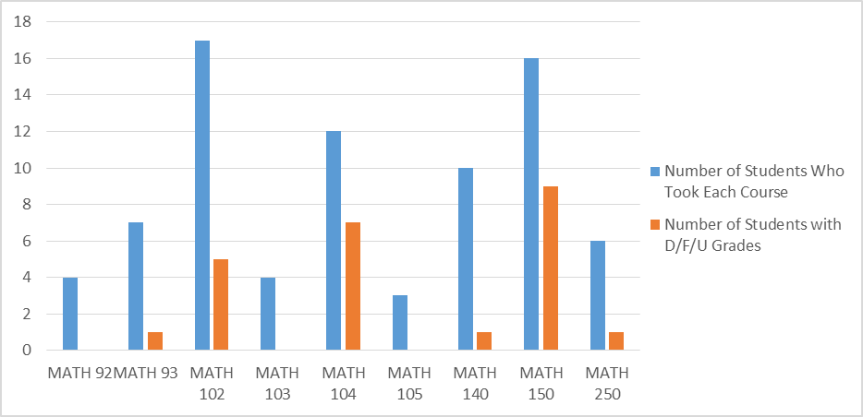
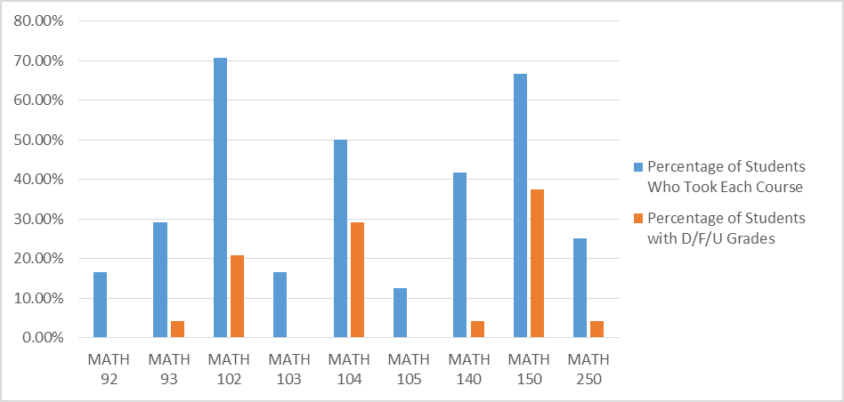
Data Analysis & Observations-Cont’d
Performance of ME FTF Students, who Changed Major and Graduated, in MATH Courses – Fall 2011 Cohort
Correlation between Number of Years to Graduate & Year of Major Change – ME FTF Fall 2011 Cohort
Potential Groups to Increase the Percentage of Graduation in 4 Years – ME FTF Fall 2011 Cohort
#yrs to graduate | #yrs between admission and major change | Did change major more than once?
3.5 | 1 | N
4 | 1.5 | N
4 | 1.5 | N
4.5 | 1 | Y
4.5 | 2.5 | N
5 | 1.5 | N
5 | 2 | N
5 | 2 | N
5 | 3 | Y
5 | 3.5 | Y
5 | 3.5 | Y
5 | 4 | Y
5 | 4.5 | Y
5.5 | 5 | N
6 | 1.5 | N
6 | 2.5 | N
6 | 3 | Y
6 | 3 | Y
6 | 4 | N
6 | 4 | Y
6 | 4.5 | Y
6 | 4.5 | N
6 | 5 | Y
#yrs to graduate | #yrs between admission and major change | Did change major more than once?
3.5 | 1 | N
4 | 1.5 | N
4 | 1.5 | N
4.5 | 1 | Y
4.5 | 2.5 | N
5 | 1.5 | N
5 | 2 | N
5 | 2 | N
5 | 3 | Y
5 | 3.5 | Y
5 | 3.5 | Y
5 | 4 | Y
5 | 4.5 | Y
5.5 | 5 | N
6 | 1.5 | N
6 | 2.5 | N
6 | 3 | Y
6 | 3 | Y
6 | 4 | N
6 | 4 | Y
6 | 4.5 | Y
6 | 4.5 | N
6 | 5 | Y
#yrs to graduate | #yrs between admission and major change | Did change major more than once?
3.5 | 1 | N
4 | 1.5 | N
4 | 1.5 | N
4.5 | 1 | Y
4.5 | 2.5 | N
5 | 1.5 | N
5 | 2 | N
5 | 2 | N
5 | 3 | Y
5 | 3.5 | Y
5 | 3.5 | Y
5 | 4 | Y
5 | 4.5 | Y
5.5 | 5 | N
6 | 1.5 | N
6 | 2.5 | N
6 | 3 | Y
6 | 3 | Y
6 | 4 | N
6 | 4 | Y
6 | 4.5 | Y
6 | 4.5 | N
6 | 5 | Y
Number of Years to Graduate for ME FTF Students who Changed Major – Fall 2011 Cohort
Increase the 4-year graduation from 5.33% to:
5.33% + 3.33%+2.67% = 11.33%
Maybe, even to:
11.33% + 3.33%+2% = 16.66%
High degree of correlation between the year of major change and number of years to graduate:
Changing the major earlier can reduce the length of graduation
Increase the 4-year graduation from 11.33% to:
11.33% + 4% = 15.33%
Years to Graduation | 4 years | 5 years | 6 years | > 6 years | Total
Graduated from another ECS Major | 0.67% | 0.67% | 1.33% | 0.00% | 2.67%
Graduated from a non-ECS Major | 2.00% | 6.00% | 5.33% | 0.00% | 13.33%
Total | 2.67% | 6.67% | 6.67% | 0.00% | 16.00%
2.67%
3.33%
2.00%
3.33%
4%

Slide 5
Concluding Thoughts
Changing major and graduating earlier has a high level of correlation with each other.
Struggling in MATH courses; especially MATH 102, 104 and 150, were a major trigger for ME FTF students to change major.
Not taking MATH courses each and every semester lengthens the period of graduation.
Students must take MATH pre-requisites from very beginning and each and every semester. This allows them and their advisor to evaluate their performance in these courses and recognize any potential need to change major earlier.
Student advisors need to monitor the performance of students in critical courses, such as MATH courses, look into the trend of students’ low/failing grades as well as the trend of repeating courses. [There could be a developed “Decision Support System” or an “Artificial Intelligent System” that gets the information of each student and provides recommendations through data; e.g. trend analysis.]
It is critical to change major in a timely manner after recognizing the need for it.
Help students identify the right major based on their capabilities and their struggles the first time they decide to change major. Changing major more than once postpones the graduation.
Students should come to engineering majors with much better preparedness in MATH courses. Those who started from MATH 92 and MATH 93 cannot graduate in a reasonable time. (Even few of those graduate at all; roughly 25% in Fall 2011 Cohort for all ECS majors.)
There could be some requirements for the minimum level of MATH preparedness to those who are interested in being admitted to an engineering major.

