Slide 1
Accessibility (A11y) & Universal Design
Notes:
The Universal Design Center collaborates with various groups on campus to support Universal Design and Accessibility efforts. Our goal is to support the process - accessibility does not happen overnight.

Slide 2
What is Accessibility and Universal Design?
ACCESSIBILITY
UNIVERSAL DESIGN
Guidelines to ensure everyone can perceive, understand, engage, navigate, and interact with information and communication technology without barriers.
Design that is simple, useful and accommodates a wide range of individual preferences and abilities.
For everyone!
Notes:
Accessibility is the ability to access information so that everyone can perceive or view what is being conveyed, operate or interact with information, understand regardless of different learning styles and abilities and be able to access using various platforms and technologies
Universal Design started in architecture: creating spaces that work for everyone, spaces that are inclusive. Whether you’re short or tall, young or old, or have a disability.
Universal Design is the design of products and environments that are simple, useful and accommodates all people to meet individuals’ preferences and abilities.
Universal Design ties into a concept called universal design for learning to emphasize how learning can be made accessible and effective for all.

Slide 3
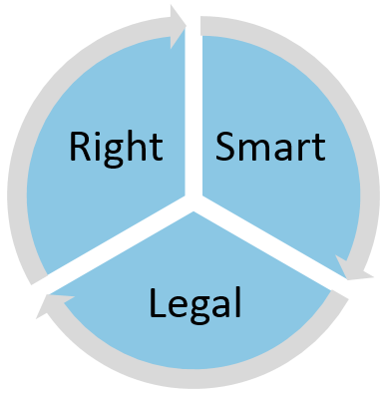
Accessibility, it’s the _____ thing to do!
Right:
Aligns with university mission & vision
Equitable and inclusive
Increases usability for all people
Attracts students to university
Legal:
Equal access under laws such as ADA, Section 508
Department of Justice scrutiny
Risk of litigation
Smart:
Sustainable
Creates a welcoming environment
Large number of population has disability (~20% of U.S. population)
Supports student success and persistence
Notes:
Circular diagram divided into 3 equal sections each titled right, smart, legal.

Slide 4
Law and Policy
Accessible Technology Initiative
Instructional Materials
Web
Procurement
CSU E.O. 1111
"It is the policy of the CSU to make information technology resources and services accessible to all CSU students, faculty, staff and the general public regardless of disability.” (E.O. 926)
State of California Government Code Section 11135
Requiring all of its agencies and departments to comply with federal Section 508.
Section 508 (Rehabilitation Act of 1973)
Requires CSUN to go further and make our information and communication technologies accessible to everyone.
Americans with Disabilities Act (ADA), 1990
Prohibits discrimination and ensures equal opportunity for persons with disabilities in employment, state and local government services, [and] public accommodations. The ADA extends to and includes the technologies used by the campus.
Learn more about Laws and Policies

Slide 5
Understanding Abilities
Accessibility is not about disability; it’s actually about ability. It’s about making it easy for everyone to:
Acquire the same information
Engage in the same interactions
Enjoy the same services
Notes:
All content produced by CSUN must be accessible. That includes:
Office documents and PDFs
Websites
Videos
Forms
Emails
Accessible to everyone means:
Easy to get
Easy to understand
Easy to use

Slide 6
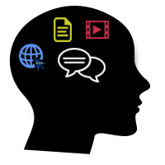
Range of Accessibility Guidelines
VISION
Low vision, blind, colorblind, etc.
Screen readers
Braille display
High contrast settings
Magnifiers
HEARING
Deaf, hard of hearing, noisy environment
Sign language
Captions/Subtitles
Transcripts
MOBILITY
Muscular dystrophy, arthritis, injury, etc.
Keyboard only
Speech to text
COGNITIVE
Learning disability, dyslexia, ADHD, etc.
Information organization
Layout
Navigation
LEARNING
Learning styles, preferences, etc.
Visual learners
English Speakers of Other Languages (ESOL)
Notes:
Vision: we're talking about folks who have no vision or low vision so the types of assistive technology they might be using are screen readers, high contrast settings, or magnifiers.
Hearing: multimedia needs to be captioning. If you’re giving a presentation, consider having a sign language interpreter for deaf or hard of hearing audience.
Mobility: physical mobility make sure document easy to navigate. Electronic mobility view documents across multiple devices.
Cognitive: content and layout structure organization.
Learning: learning styles, preferences, etc.

Slide 7
Need for Accessibility
20% of the U.S. population has at least one disability (U.S. Census Bureau: Disability [2010])
11% of college students report a disability (U.S. Department of Education, National Center for Education Statistics. [2016])
Nearly 1 in 5 people have disability in the U.S. (U.S. Census Bureau Reports [2010])

Slide 8
Assistive Technology (AT)
Products, equipment, and systems that enhance learning, working, and daily living for persons with disabilities.
Example: Screen readers are a form of assistive technology software that enable access to a computer, and all the things a computer does, by attempting to identify and interpret what is being displayed on the computer screen using text-to-speech. Screen readers can only access and process live text (fully editable or selectable text).
Screen reader
Provides access to someone who is visually impaired, mobility or has a learning disability to access text on the screen.
Offers same level of independence and privacy as anyone else.
Notes:
Text-to-speech benefits masses – universal design

Slide 9
Universal Design for Everyone
Following accessibility guidelines and designing for the widest possible audience benefits all students
Example: Closed captions, used by:
Deaf and hard of hearing students
English speakers of other languages (ESOL)
Anyone studying
a video with poor sound
in a noisy environment, or where they need to remain quiet
a technical subject or one with jargon or acronyms

Slide 10
Universal Design Principles
1. Equitable use. The design is useful and marketable to people with diverse abilities. For example, a website that is designed to be accessible to everyone, including people who are blind and use screen reader technology, employs this principle.
2. Flexibility in use. The design accommodates a wide range of individual preferences and abilities. An example is a museum that allows visitors to choose to read or listen to the description of the contents of a display case.
3. Simple and intuitive. Use of the design is easy to understand, regardless of the user's experience, knowledge, language skills, or current concentration level. Science lab equipment with clear and intuitive control buttons is an example of an application of this principle.
4. Perceptible information. The design communicates necessary information effectively to the user, regardless of ambient conditions or the user's sensory abilities. An example of this principle is captioned television programming projected in a noisy sports bar.
5. Tolerance for error. The design minimizes hazards and the adverse consequences of accidental or unintended actions. An example of a product applying this principle is software applications that provide guidance when the user makes an inappropriate selection.
6. Low physical effort. The design can be used efficiently, comfortably, and with a minimum of fatigue. Doors that open automatically for people with a wide variety of physical characteristics demonstrate the application of this principle.
7. Size and space for approach and use. Appropriate size and space is provided for approach, reach, manipulation, and use regardless of the user's body size, posture, or mobility. A flexible work area designed for use by employees who are left- or right-handed and have a variety of other physical characteristics and abilities is an example of applying this principle.
Universal Design: Process, Principles, and Applications (UW)

Slide 11
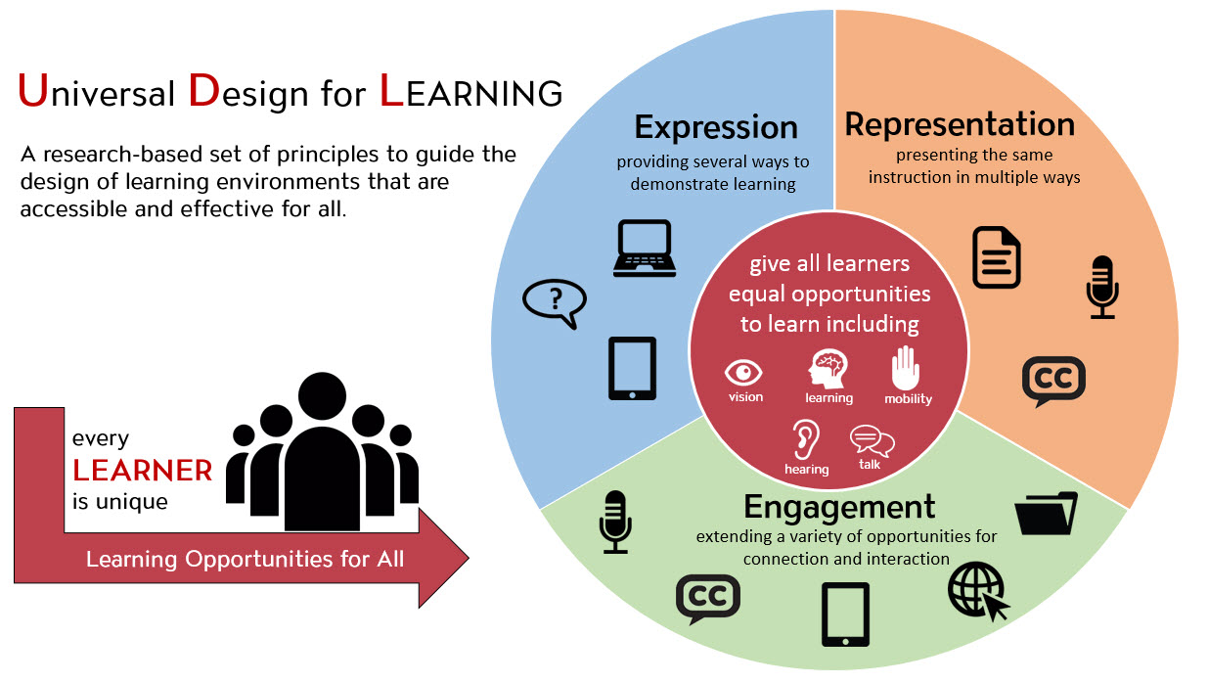
Universal Design for LEARNING, 1 of 2
Inspired by Universal Design, Universal Design for Learning (UDL) applies these concepts in the education context, with the goal of minimizing barriers and maximizing learning for all students.

Slide 12
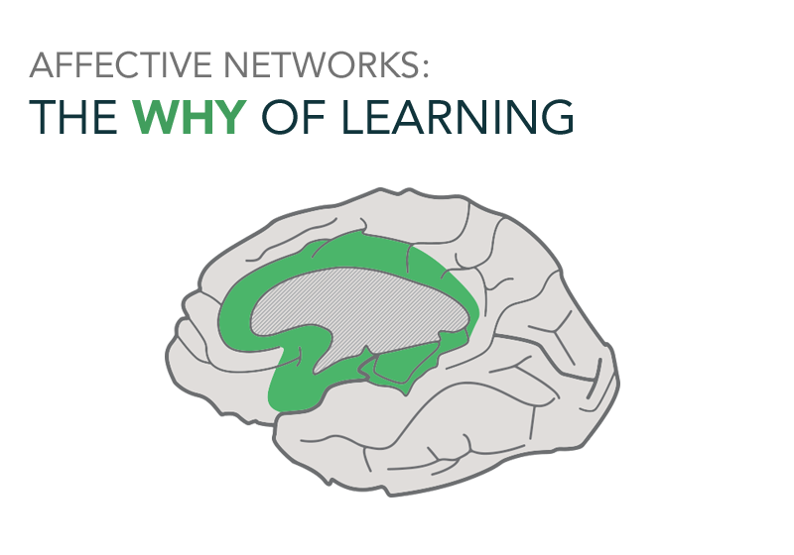
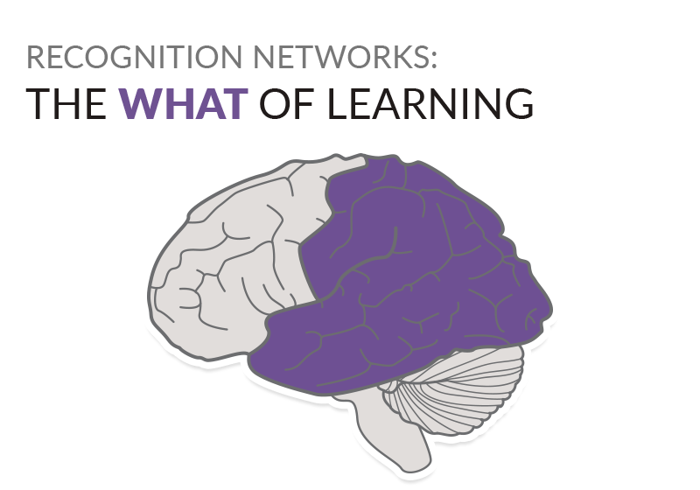
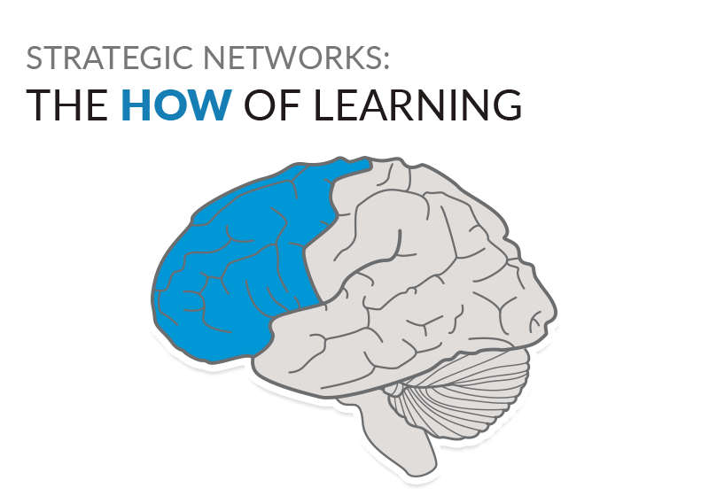
Universal Design for LEARNING, 2 of 2
ENGAGEMENT: Look for different ways to motivate and inspire students
Example: Interactive skill-building exercises
REPRESENTATION: Present information and content in different ways
Example: Captions and transcripts to accompany audiovisual materials
ACTION & EXPRESSION: Provide multiple ways for students to interact with material and express their knowledge
Example: Tests that include different question types such as long answer and multiple choice
Visit CAST UDL Guidelines

Slide 13
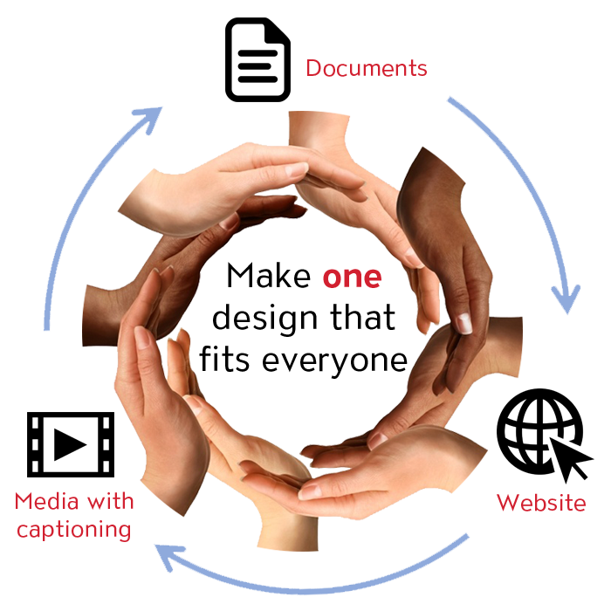
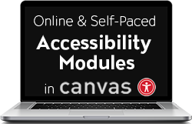
How can we help you make a difference?
Universal Design Center Offers
Online, self-paced training
In-person training each semester
Consultations
Tools and Services
Universal Design means design for everyone

Slide 14
CSUN Training and Support
Summer Bootcamps and Learning Tracks
Accessibility Bootcamp
4-day
30 participants
Accessibility & Accommodations
1-day learning track, joint by
UDC
NCOD: Deaf and Hard of Hearing Services
Disability Resources and Educational Services (DRES)
28 participants total (2 sessions)
UDC Fall Training Series includes:
Accessible Video Design
Canvas Ally
EquatIO for STEM Accessibility
Flyers & Infographics
Accessibility for Word, PowerPoint, and PDF
UDC offers consultations too!

Slide 15
Introductions to Accessibility: Documents & Web Content October 2021 – June 2022
The Chancellor's Office and WebAIM have launched the next phase of accessibility training for The California State University employees.
Learn more about WebAIM Accessible Documents & Web Training.
Notes:
Accessibility is never done!
It is always a moving target.

Slide 16
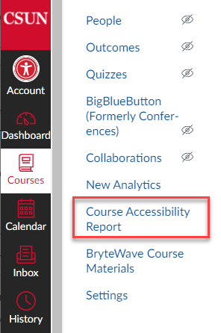
Canvas Ally & Course Accessibility Report
Ally guides faculty to improve the accessibility of course materials within Canvas
Visual indicators (dials) for each file
Step-by-step instructions to fix
Course Accessibility Report
New for Fall 2021
Every course in Canvas has this report including
Easiest issues to fix
Lowest scoring content

Slide 17
Captioning
Central campus fund to caption videos used for instruction
Priority given to classes with accommodations, external videos that will be used for multiple semesters
Faculty submit request(s) through NCOD: Deaf and Hard of Hearing Services
For faculty-created videos, Panopto offers rich captioning features

Slide 18
EquatIO for Math, Chemistry, Physics
Software to translate equations into accessible digital formats
Available
In Canvas
Chrome browser plug-in
Windows or Mac
Mobile
Accepts a variety of formats including handwritten
Includes LaTeX editor
For students too!
EquatIO for STEM Accessibility

Slide 19
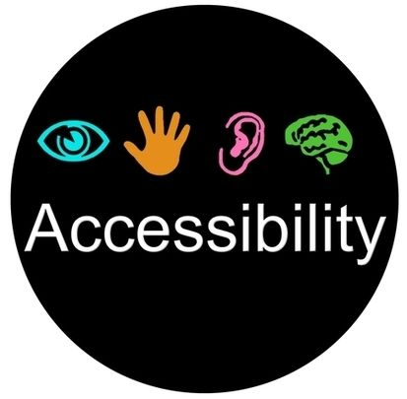
Accessibility is a Journey
You can’t build an accessible content overnight. It’s making progress one step at a time. One small moment of victory propelling you forward to the next. Accessibility is a constant journey, not an end destination.
Notes:
Accessibility is never done!
It is always a moving target.

