Slide 1
Deans and Chairs Retreat – Fall 2021
Dr. William Watkins, Vice President of Student Affairs and Dean of Students
Matthew Cahn, Vice Provost
Kristina de la Vega, AVP Human Resources
August 2021

Slide 2
Discussion Topics
1
2
3
Student Guidance / Student Life
Employee Safety Protocols / Resources
Faculty Specific Guidance/Resources

Slide 3
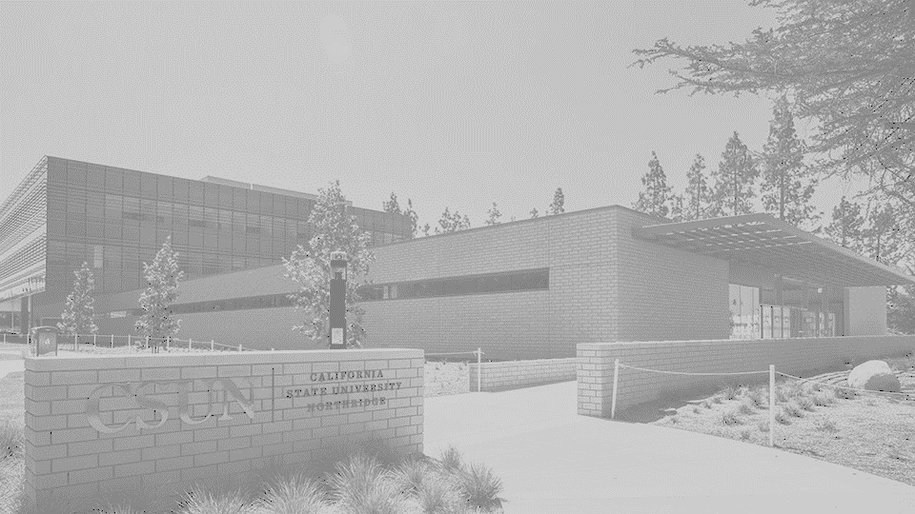
z
STUDENT GUIDANCE
Get vaccinated or choose to take classes online and remain off campus
Complete certification of vaccination status online at myHealth portal. Options: a) fully vaccinated, b) qualified for medical or religious exemption, or c) not coming to campus. Some attestations will be verified
If required, participate in testing protocol
Complete health-screening and only come to campus if cleared
Universal face covering: required inside offices, building spaces and classrooms. Anticipate requiring in outside group situations
Physical distancing will be facilitated and encouraged
May directed to leave when non-compliant
May be disciplined for misconduct such as dishonesty
We must take care of our collective health and well being
Students who are not compliant by September 30th will not be able to continue coming to campus

Slide 4
z
STUDENT LIFE AND SUPPORT
Student Housing will be limited to 70 - 75% occupancy; must be fully vacc. with weekly testing
New student orientation is primarily virtual with small group campus tours. Cultural welcomes.
AS Senate will continue to meet virtually
Childrens Center is already open and filled
The USU and Rec Center will be open. Space utilization will be limited to 50% of capacity, with distancing, face covering and only pre-wrapped/boxed food to go
Meet the Clubs Day being planned and will be virtual
Guidance for clubs and organizations still being developed
New Student Convocation is being scheduled as a virtual event
Sport clubs and intramurals will be planned without spectators
Student Health Center never closed!
Expanded basic needs initiative with added days in food pantry and rapid rehousing
Students have received three emergency aid grants. Another set for after census.
Significantly increased mental health support

Slide 5
z
EMPLOYEE SAFETY PROTOCOLS
Do not come to campus if sick
Self-Screening Survey - Employee Health Screening Survey
Face covering
Optional outdoors, except in large crowds, venues, etc.
Required indoors except in closed private office with door closed or when eating/drinking (provided 6-foot distancing can be maintained)
Physical distancing – Encouraged, while not mandated
Regularly wash hands
Reporting COVID-19 Cases / Exposure
Faculty and Staff Self-Reporting Form
Manager Reporting Form (for managers to report employee/student employee cases)
Shared responsibility

Slide 6
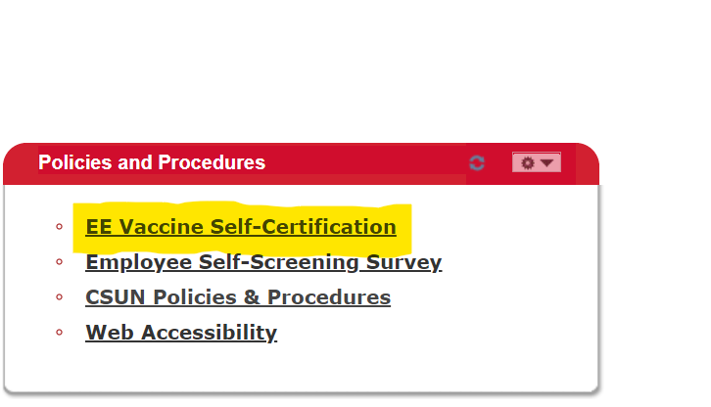
z
VACCINATION INFORMATION
CSU mandated for all students and employees by September 30, 2021
Employees may self-certify vaccination status in MyNorthridge portal.
Exemptions may be requested for medical or religious reasons.
Notes:
Note – CSU still meeting and conferring with union partners. In the interim, we encourage employees to voluntarily self-certify vaccination status to opt out of weekly COVID testing.

Slide 7
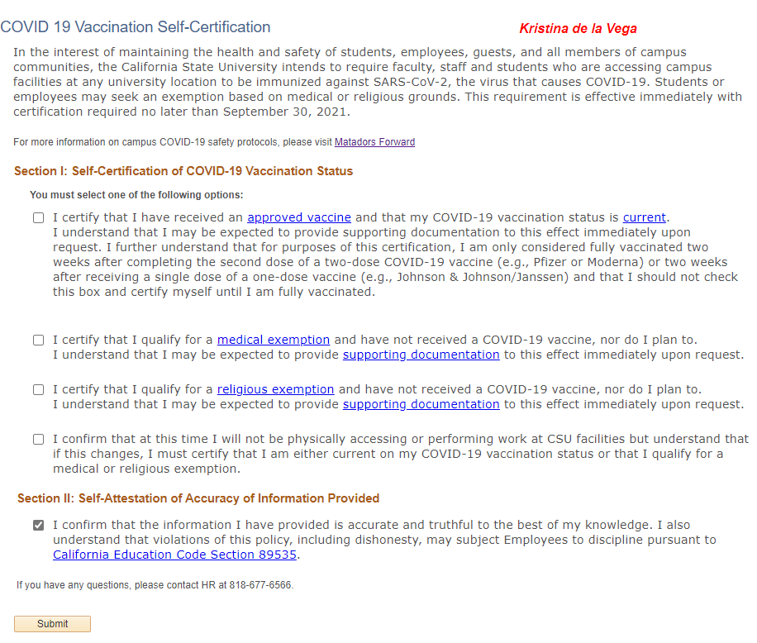
z
VACCINATION SELF-CERTIFICATION
Notes:
- added ability to upload vaccination card for SUPA and CSUEU

Slide 8
z
COVID-19 TESTING
Weekly testing is required for employees who do not self-certify vaccination status by the start of the fall 2021 semester or who have been provided medical/religious exemption.
Negative COVID-19 test will be required prior to campus classes starting, August 30, 2021 (up to 7 days prior) and then weekly thereafter.
Test is a PCR nasal swab administered by a third-party vendor.
Testing is free and conducted during employee work hours.
Employees who have certified their vaccination status may voluntarily choose to participate in testing.
Employees will have the option to test on-site or have a test kit mailed home.
Testing on campus will not be an option for someone who is experiencing symptoms.

Slide 9
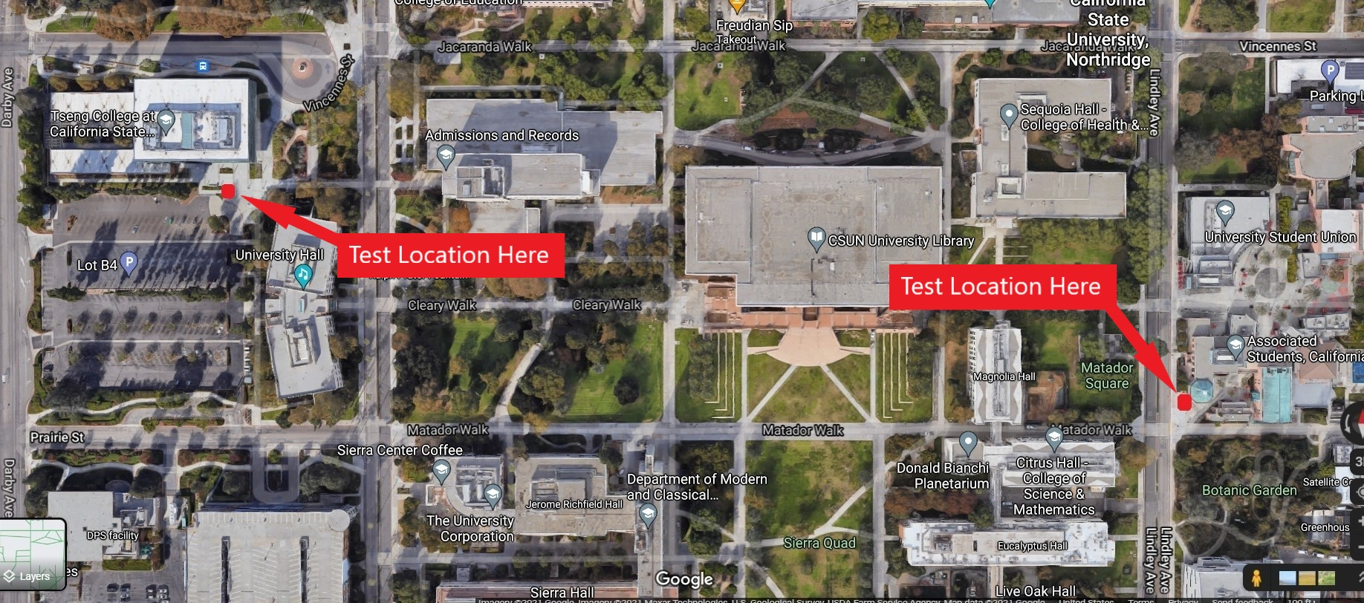
z
TESTING OPTIONS
On campus testing
Monday - Friday, 11 a.m. to 7 p.m.
Kiosks located near the Extended University Commons and University Student Union (USU) Freudian Sip.
Test results will be provided 24 - 48 hours after test date through secure vendor portal.
Testing from home
The test kits will be mailed to the homes of employees for self-administration and then employees will drop off the test sample at any FedEx location.
Test results will be provided 24 – 48 hours after the lab receives the mailed test kit through secure vendor portal.

Slide 10
z
EMPLOYEE RESOURCES
Faculty and Staff Fall Guidelines | California State University, Northridge (csun.edu)
Department COVID Coordinator – health and safety, under CSUN COVID-19 Contacts and Department COVID-19 Coordinators
Ambassador Program – health and safety, under health and safety resources
COVID Leaves (ECRL) – under work schedule
Medical Accommodations – under work schedule
Employee Assistance Program – health and safety, under health and safety resources
Staff – HR Employee Relations er@csun.edu or 818-677-6566
Faculty – Faculty Affairs 818-677-2962
Notes:
Safety notes:
-the campus has stocked-up on heavily on PPE’s
COVID coordinators:
-All work areas were thoroughly assessed & had social distancing measures, signage, etc. installed in early stages of pandemic.
-Every dept. has a COVID coordinator who will work with EH&S as necessary to make any necessary updates to their plan for fall
Adherence to standards:
-shared responsibility for the entire campus community
-student ambassadors at major buildings. Will have masks, info., etc.
-mask and distancing enforcement is not a campus police activity (CSUN is similar to most public locations where compliance is generally good overall).
-Instructors, managers will utilize similar methods to deal with non-compliance in the classroom or workspace as they do with other types of disturbances or non-compliance (e.g. instructors have authority to ask students to leave class, and office personnel have authority to ask visitors to leave the office, until the concerning behavior is addressed. Classes and offices will be equipped with extra disposable face coverings to assist with compliance efforts.
-strive to deescalate and avoid confrontation.
**Presenters should take care to speak of non-compliance protocols in terms of all campus community members and visitors (i.e. avoid inordinately emphasizing student behavior)

Slide 11
z
FACULTY GUIDANCE
Faculty will need to take attendance in each in-person class through canvas.
Faculty should reach out early to students (before class begins) to remind students of need to be compliant with vaccine policy before they come to first on-campus session, including being fully vaccinated or tested before attending class.
Faculty should not ask a student’s vaccine status or attestation compliance status – that will be done through a back-office process.
Faculty may remind students to take daily health clearance before coming to campus and may remind students that if they are not compliant with the attestation process they need to do that asap.
An FAQ is coming directly to faculty and chairs addressing these and providing stepwise guidance.

Slide 12
z
MATADORS FORWARD WEBSITE
www.csun.edu/matadors-forward
Notes:
The Matadors Forward website will be the primary repository for up to date information. Please bookmark it!! Includes FAQs and other important content.
Thank you for your commitment to our students, for being resilient, and for the critical work you do in support of our students and campus community.
As safety is a shared responsibility, please help and do your part.

Slide 13
z
QUESTIONS
Notes:
The Matadors Forward website will be the primary repository for up to date information. Please bookmark it!! Includes FAQs and other important content.
Thank you for your commitment to our students, for being resilient, and for the critical work you do in support of our students and campus community.
As safety is a shared responsibility, please help and do your part.

