Slide 1
Things I Wish I Had Known as A New Chair
August 20, 2021
Rosa M Angulo-Barroso (Kinesiology)
Sal Esparza (Health Sciences)
AJ Kim (Theatre)

Slide 2
Kinesiology
My experience as a new department Chair
Let’s start with a little context about my department
The Department of Kinesiology is a large and diverse department with about 100 instructors and close to 2000 students, 5 options, two Master programs, and a Community-Service-Teaching-Research Center. Our facilities are very large and complex due to physical activity classes, and it is partially shared with Athletics (a super power at CSUN) and the RTM Department.
When I became the new Chair, the dialog between the Department and the College was very deteriorated to the point of no communication. In addition, two relatively new tenure track faculty resigned during my 1-year tenure. Furthermore, due to lack of proactive diligence from the part of administrative CSUN a new Master program had to be cancelled and postponed….
As you can imagine, it has not been an easy year as a new Chair of the Department.

Slide 3
I wish I had known. .
1. Who is who at the administrative level – so I started an informal repository of names and contact info for “important” people at the CSUN level (see Picture below)
2. What are the important “pieces” of the CBA, Section 600 and Section 700 as a Dept Chair. Make sure you become familiar with https://www.csun.edu/faculty-affairs/policies
3. How to effectively look for information related to my job – it takes time to know where to go in the CSUN website to find out the needed information, and how to navigate the CSUN Counts dashboards

Slide 4
I wish I had known
4. How to run the different reports to build and check the SOC – I still rely on my department coordinator
5. How to create a comprehensive deadline calendar for all the required/policy issues related to FTF, PTF and staff. I had to build it as I was doing, which is not very useful.
6. That unless I force myself to set up time aside for (1) creating a strategic plan for the department, and (2) research activities, these things will not happen
7. That as a Dept Chair you have almost no decision power, but you can however be a nagging requester that finally/hopefully will be heard
8. That a pandemic just started and was going to be with us for a long time!!!! Creating uncertainty, and testing everyone’s patience

Slide 5
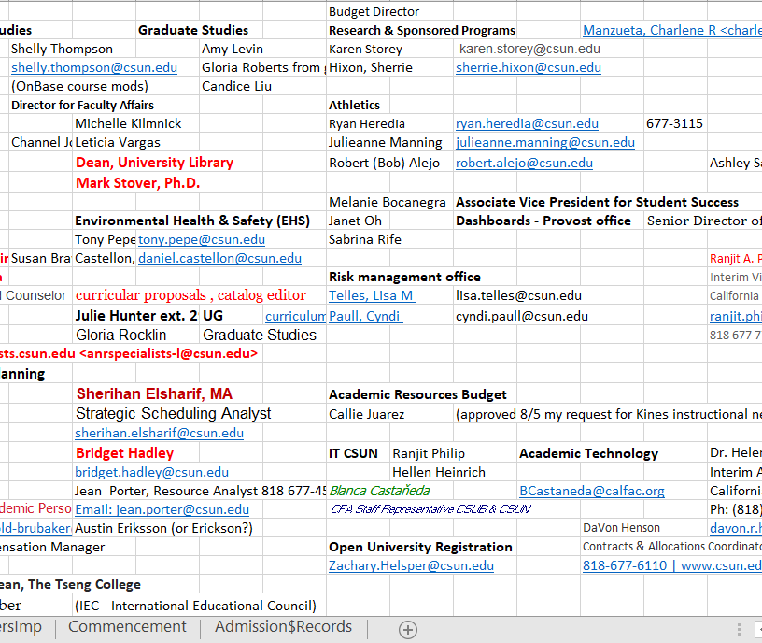
Who’s Who Chart

Slide 6
Health Sciences
INTERPERSONAL RELATIONSHIPS
IN HIGHER EDUCATION
· “A group of anarchist held together by a common
parking lot.”
· “No wo/man is an island.”
· When groups of people work together, interpersonal conflicts are bound to arise.
· Conflicts arise for a variety of reasons:
· Poor communication**
· Personality clashes
· Different work styles and values
· Unhealthy workplace competition
Background

Slide 8
· Five quick tips to help academic leaders wisely manage interpersonal conflict and dispute among colleagues:
1. Step back and assess
2. Prepare
3. Stay calm and stick to facts
4. Use low-key language
5. Stay on the high road

Slide 9
Theatre
I wish I had known . . .
The global pandemic would not end in 2020!

Slide 10
Self-Care!
· Download a meditation app on your cell.
· Set aside a block of time for daily walks or other activities.
· Build a support system – family, friends, and colleagues.
· It’s ok to not have answers right away.
· Mistakes are petition-able at CSUN!

Slide 11
Self-Care!
“Some people come in your life as blessings, some as lessons.” –Mother Teresa
“When anger rises, think of the consequences.” –Confucius
“Keep smiling; it keeps your friends happy and makes your enemies worry. --CSUN Emeritus Faculty 28 years ago
“Always forgive your enemies, nothing annoys them so much.” --Oscar Wilde
“Forget, forgive, conclude, and be agreed.” –Shakespeare

Slide 12
Self-Care!
“The end of labor is to gain leisure!” – Aristotle
Use your vacation time!

