Slide 1
Academic Affairs Budget New Department Chair Orientation
August 20, 2021
Callie Juarez
Director of Academic Budget Management

Slide 2
Agenda
Introductions
Budget Overview
CSUN Budget
Department Budgeting
Faculty Position Funding
Best Practices and Tools
Q&A
Notes:
DIANE

Slide 3
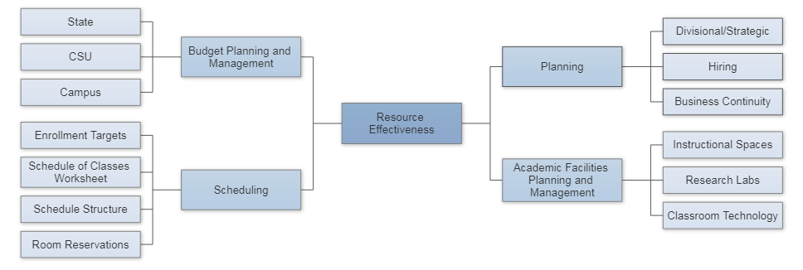
The Resource Planning Environment in Academic Affairs
Department of Academic Resources and Planning
Notes:
DIANE

Slide 4
Budget Overview
Notes:
DIANE

Slide 5
What is a budget?
noun: an estimate, often itemized, of expected income (or allotment) available for spending that is based on a plan for how it will be spent for a given period of time.
Notes:
DIANE

Slide 6
A budget can serve multiple purposes:
A forecast of planned revenues, expenditures and saving
A tool for the allocation of current and anticipated financial resources
A means to promote good management
A controlling instrument
A method of communication
A reflection of the organizational values
Notes:
DIANE

Slide 7
What is the difference between accounting, budgeting and finance?
Source: www.wacubo.org
Notes:
DIANE

Slide 8
Funds and Fund Accounting
General Accounting
An accounting system that emphasizes accountability rather than profitability
Fund Accounting
Self-balancing set of accounts, with identified sources of income and segregated for specific uses in accordance with laws, regulations, or special restrictions or limitations
Notes:
DIANE

Slide 9
CSUN Budget
Notes:
CALLIE

Slide 10
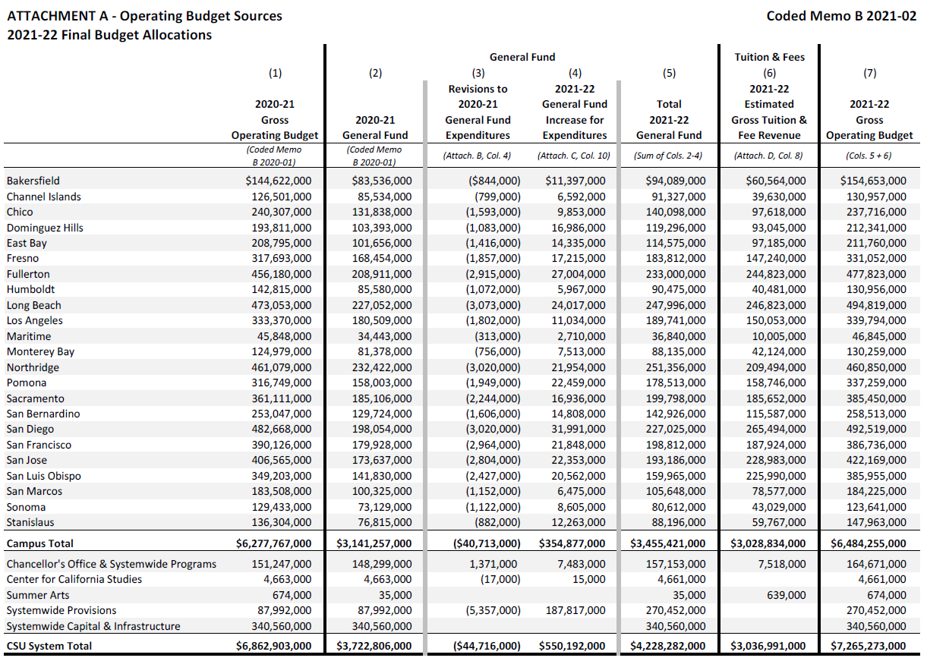
CSU Budget
Northridge is 6.3% of Total CSU General Fund Budget
Total CSUN General Fund Budget = $460M
Notes:
DIANE

Slide 11
What is a budget? A PLAN!
CSUN budget is $1 million less than 21/22
What happened – weren’t budgets
restored??
What is in the plan at the CSU for Northridge?
Retirement Benefits (above state funded at 2013)
Return of funds to the CSU for system priorities
Restoration of 20-21 General Fund Reduction
GI 2025
AB 1460 Ethnic Studies
Reduction in estimated FTES

Slide 12
Unfunded Mandates

Slide 13
CSUN Budget (Budget Dashboard – OpenBook)
https://www.csun.edu/afvp/budget
Notes:
CALLIE

Slide 14
CSUN Policy on Fiscal Responsibility
Ensure that:
Expenditures don’t exceed available resources
Funds expended for intended purposes in appropriate time period
Use internal controls to protect from misuse
Correctly classify receipts and expenditures
Comply with campus policies

Slide 15
Department Budgets
Notes:
CALLIE
Now we are going to review the Division of Academic Affairs budget

Slide 16
Typical “State-Side” Funds in Academic Departments
Fees in General Fund (appropriations, allocations, and fee revenue) – 48501
Research, Scholarship, and Creative Awards (RSCA) – 48518
Campus Quality Fee (CQF)
Course materials - 48520
Student support - 48521
Technology – 48522
State Trust Fund (includes TExL MOU revenues, IRA, etc.) – 496XX, 444XX, etc.
Lottery Fund – 48101
Notes:
CALLIE
General Fund – Instructional budget: faculty and staff salaries, operating for colleges and departments
RSCA – awarded through Research and Graduate Studies. Funded by the Chancellor’s Office
CQF – all students pay a common fee that replaced course/lab specific fees. Those funds are split between allocation to the departments for course materials fees (augment operating budget for course/lab specific needs). Student support and Technology – proposal submitted in Dec. Awarded in June.
TExL Extended Learning which includes: Semester at CSUN (SAC), winter and summer revenue, MOUs from degree and certificate programs
IRA – Instructional Related Activities fund – Additional student fee, proposal and award
Lottery – Colleges receive allocation for refresh and new instructional equipment

Slide 17
Department Auxiliary Funds
Auxiliary Funds (separate 501(c)(3) entities)
The University Corporation (TUC)
TUC provides commercial and administrative services to CSUN and also manages sponsored programs.
Sponsored programs grantor is an agency of the local, state, or federal government.
CSUN Foundation
The CSUN Foundation is responsible for accepting, managing, investing and disbursing all CSUN related philanthropic funds.
Scholarships
Restricted/unrestricted gifts
Notes:
CALLIE
Focus on philanthropy
Each foundation fund is classified as restricted or unrestricted – work with Director to determine what funds are available to the department

Slide 18
The Decentralized Model Principles
Communication and Disclosure
ERC Recommendation
College Budget Model
Clarity of Business Practices
Facilitate Sharing of Information and Open Communication
Balanced Budgets
Meet FTES Targets
Continuity/Consistency of Practices
Defensible Systems (audit readiness)
Accountability
Notes:
DIANE
CSUN has a long standing principle of the Decentralized Model
Principles focus on communicating and disclosing the budget to stakeholders (colleges to chairs and faculty)
Colleges provide a budget model to the Provost Office once a year
Units should articulate their business practices
Colleges are expected to balance their budgets and meet their FTES targets
Colleges and departments must be fiscally responsible, using the funds correctly and to benefit instruction
Accountability – CSUN is a state entity and we are ultimately responsible to the university, the CSU system, the state legislatures and the CA taxpayers

Slide 19
Role of the Director of Finance and Operations
Role of the College Directors vary and generally include:
Part of college leadership team
Advisor to dean on resource matters
Member of administrative council
Resource for department chairs, faculty, and staff
Resource management
Budget planning and management
Schedule of Classes planning (with dean or associate dean)
Technology support
Staff human resources
Space assignments and utilization
Business process improvement
Much, much more!
Notes:
CALLIE
Resources = financial, human resources, and facilities
Part of your new role as department chair is to supervise staff in the department includes providing work direction and evaluation. Talk with you MAR regarding position descriptions.
Staff HR – not only transactions & support department chairs with employee relations matters which include performance evaluations and corrective action

Slide 20
Meet with your Director of Finance and Operations
College | Director
Mike Curb College of Arts, Media, and Communication | Natali Papazyan
David Nazarian College of Business and Economics | Cathleen Fager
Michael D. Eisner College of Education | Fred Moreno
College of Engineering and Computer Science | Magda Azouz
College of Health and Human Development | Todd Oberson
College of Humanities | Janene White
College of Science and Mathematics | Nidia Goitia
College of Social and Behavioral Sciences | Serinah Gabrelian
Oviatt Library | Jamie Skeggs
Notes:
CALLIE

Slide 21
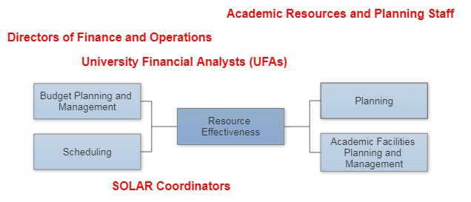
Resource Planning Staff in Academic Affairs
Notes:
CALLIE
AcR Staff provide support to the Director and college
Within the college there is the Directors
UFAs are experts/specialist regarding the finances
SOLAR Coordinators – support department with SOC: building schedule, deadlines, room utilization

Slide 22
Educational Resource Committee of the Academic Senate (ERC) Recommendation on College Budgets – 1999
Open budget reporting and consultation process
Resources and allocations for all departments, centers, and programs
Contingency funds
Maintain
Communicate to department chairs

Slide 23
Faculty Position Funding
Notes:
DIANE
Q: Are faculty automatically replaced?

Slide 24
How Does Faculty Attrition Affect the Budget?
Example: Retiring Faculty Salary $98,442
Replacement Salary Retained in College (24 units AY) (48,442)
Salary Savings $50,000
Example: Assume 15 Full-time Retirements and 20 FERPs Full-Time $750,000
FERPs 500,000
Total Contribution to Attrition Salary Savings $1,250,000
Commitments:
Annual Cost of Faculty Promotions ($650,000)
Annual Cost of Staff Promotions/Actions (400,000)
Net Available for Redistribution* $200,000
*for faculty positions, initiatives, unfunded mandates
Notes:
DIANE

Slide 25
Tenure-Track Faculty Position Funding Sources
Funded enrollment growth
Internal Academic Affairs salary savings from attrition
Notes:
DIANE
Two main sources: enrollment growth and attrition

Slide 26
FTES Growth Funding for Lecturers
Funding for schedule adjustments
Process initiated by departments and colleges when over-enrolled.
Faculty positions funded at replacement rate and when college exceeds planned internal target.
Undergraduate Studies approved FTES funded as follows:
Increase to class limit – funded at 50%
Additional sections – funded at 100%
Notes:
DIANE

Slide 27
Best Practices
Notes:
CALLIE
Are there any questions?

Slide 28
Managing the Schedule
This is the number one area of control for department chairs
Effective use of physical, fiscal, and human resources
Effectively deploy tenured and tenure-track faculty in order to maximize enrollments using “fixed costs”
Monitor/eliminate “low enrolled” sections
Notes:
CALLIE

Slide 29
Other Best Practices
Regular (monthly) account reconciliation
Line-item budgeting – Questica
Generation of alternative funds
Extended Learning, fundraising, grants/IDC
Others?
Planning
Equipment refresh
Wish lists (for windfalls, donors, etc.)
Contingencies
Notes:
DIANE

Slide 30
Other Questions?
callie.juarez@csun.edu
www.csun.edu/academic-resources-planning

