Slide 1
SPSS
Statistical Package for Social Sciences
Setting up an SPSS Data File
Department of Psychology
California State University Northridge
www.csun.edu/plunk

Slide 2
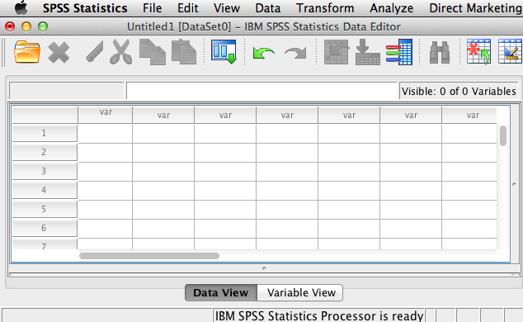
Setting up an SPSS data file
This is how the new file should look

Slide 3
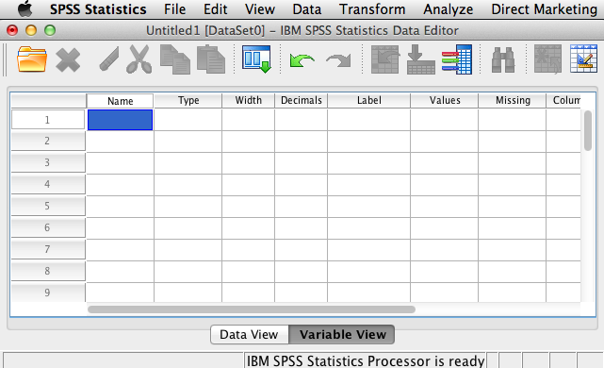
Setting up an SPSS data file
Click on variable view

Slide 4
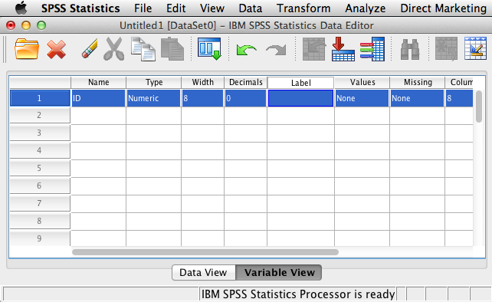
Setting up an SPSS data file
Type “ID” under Name
Type “0” under Decimals

Slide 5
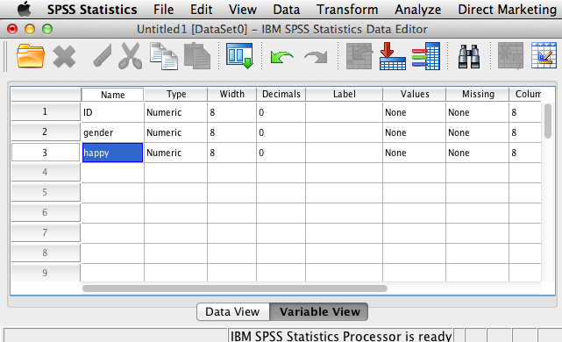
Setting up an SPSS data file
Set up your file to look like the one above.

Slide 6
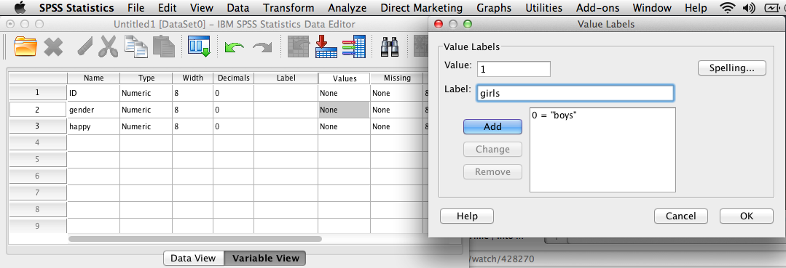
Setting up an SPSS data file
On row with “gender”, click “None” under Values
Type “0” where it says Value, type “boys” where it says Label, and click Add
Type “1” where it says Value, type “girls” where it says Label, and click Add
Click OK

Slide 7
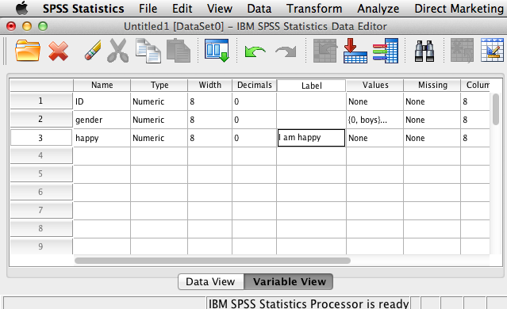
Setting up an SPSS data file
On the “happy” row, under Label, type “I am happy”
This could be the question, item, or longer label for a variable

Slide 8
Setting up an SPSS data file
On row with “happy”, click “None” under Values
Type “1” where it says Value, type “strongly disagree” where it says Label, and click Add
Add the remaining information as shown above and click OK

Slide 9
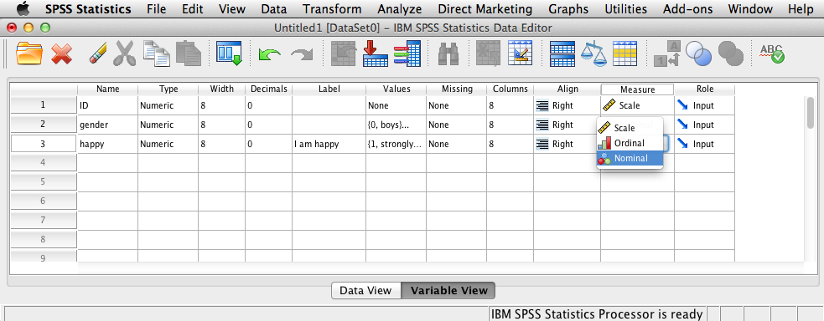
Setting up an SPSS data file
Designate variables as “Scale”, “Ordinal”, or “Nominal”
Gender would be “Nominal”
Happy would be “Ordinal”
ID could be any of the three, depending on how you use it.

Slide 10
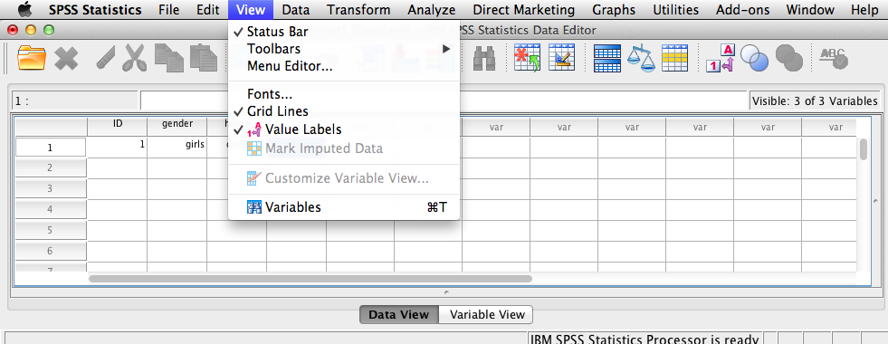
Setting up an SPSS data file
Go back to Data View, and under View, uncheck Value Labels

Slide 11
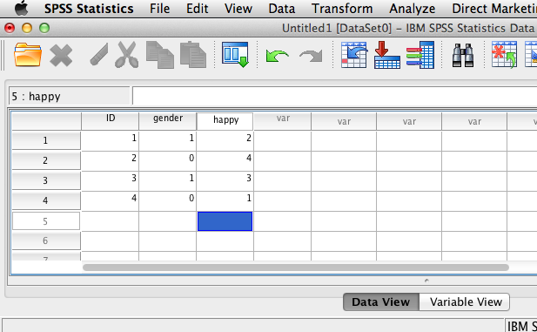
Setting up an SPSS data file
Type in the values as shown above.

Slide 12
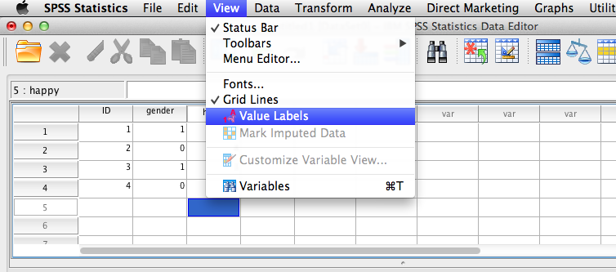
Setting up an SPSS data file
Go back under View, and check Value Labels

Slide 13
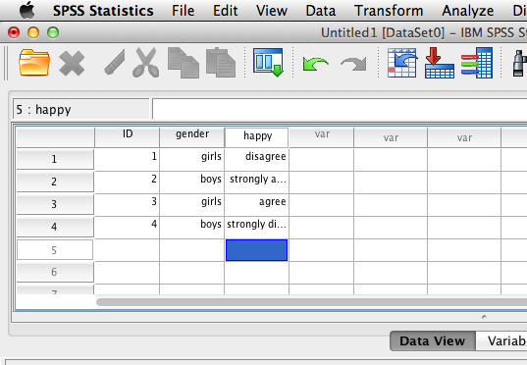
Setting up an SPSS data file
Now the values you typed in will show in your data file.
They will also show in your output.

Slide 14
Setting up an SPSS data file
Go back to the Variable View
Create a new variable named “Why”
Click on Numeric
Then click String in the pop up window
Then click OK

Slide 15
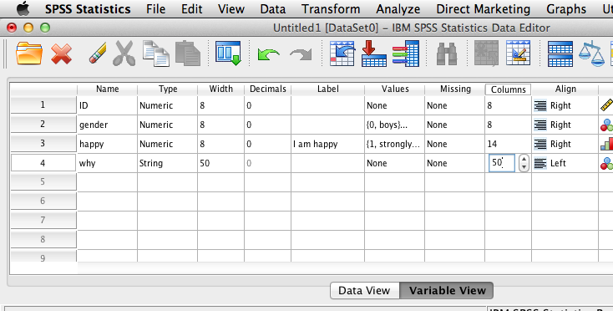
Setting up an SPSS data file
Type “50” in the Width and “50” in the Columns
Width establishes how many characters the variable can be
Columns establishes how wide it will be in Data View

Slide 16
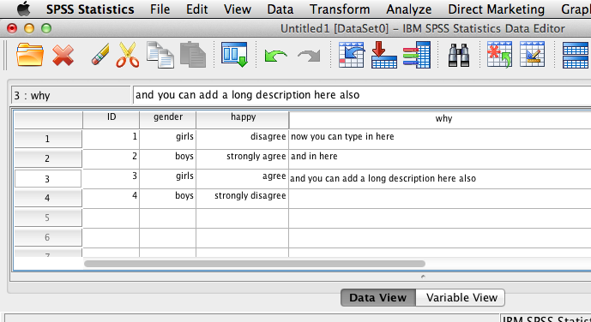
Setting up an SPSS data file
Go back to Data View
Under the variable called “Why”, you can type open ended (i.e., string) data.

