Slide 1
SPSS
Statistical Package for Social Sciences
One-Way ANOVA
Department of Psychology
California State University Northridge
www.csun.edu/plunk

Slide 2
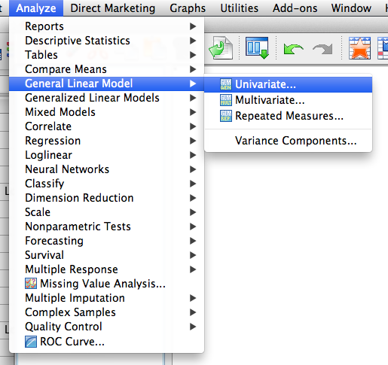
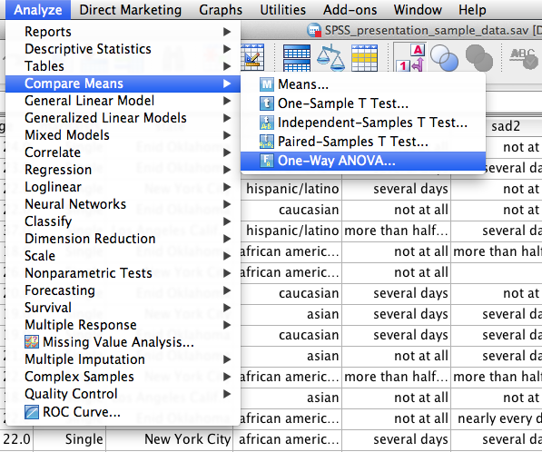
One-Way ANOVA
One-Way ANOVA examines differences between two or more groups on a dependent variable.
Although SPSS has a way to run one-way ANOVA (see figure 1), it does not have an option for the effect size. I show this method starting on slide 11.
So, run a one-way ANOVA by using the general linear model command instead (see Figure 2).
Figure 2
Figure 1

Slide 3
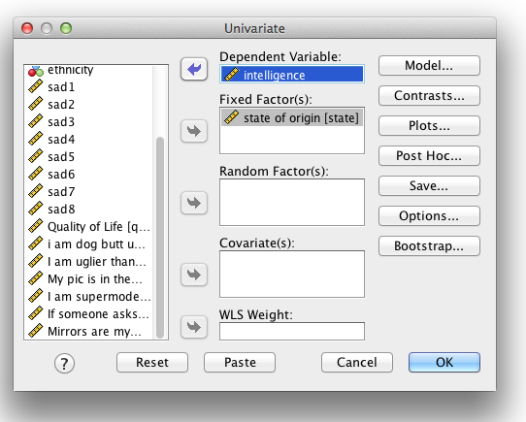
One-Way ANOVA
Move “intelligence” into the dependent variable box.
Move the independent variable (in this case “state of origin”) into fixed factors.
Click on “Options”

Slide 4
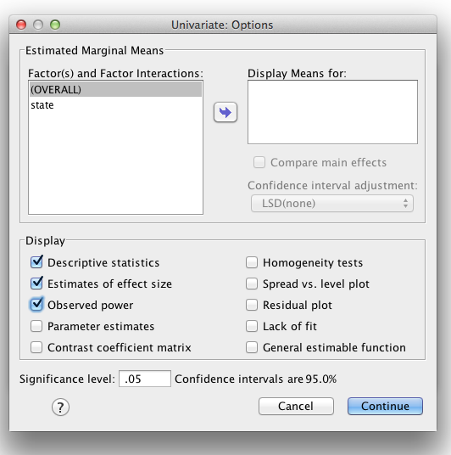
One-Way ANOVA
Under “Options”, click “Descriptive statistics” (which will print means and standard deviations for the IV), “Estimates of effect size” and “Observed power”.
I will generally examine “homogeneity tests” also.
Click “Continue”

Slide 5
One-Way ANOVA
In the univariate window, click on “Post Hoc…”
Since there are more than two groups, a post hoc analysis will need to be conducted if there are significant differences

Slide 6
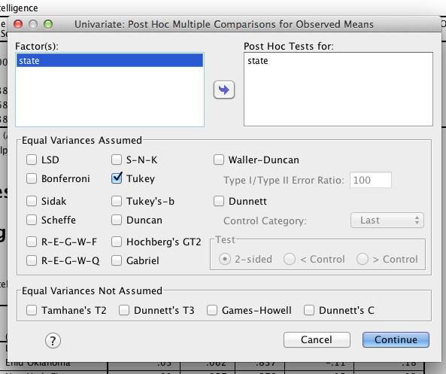
One-Way ANOVA
For this analysis, move “state” into the box that says “Post Hoc Tests for:”
Then click on “Tukey”
There are reasons to run the various types of post hoc analyses (but they are not discussed here)
Click “continue”

Slide 7
One-Way ANOVA
Click “OK”.

Slide 8
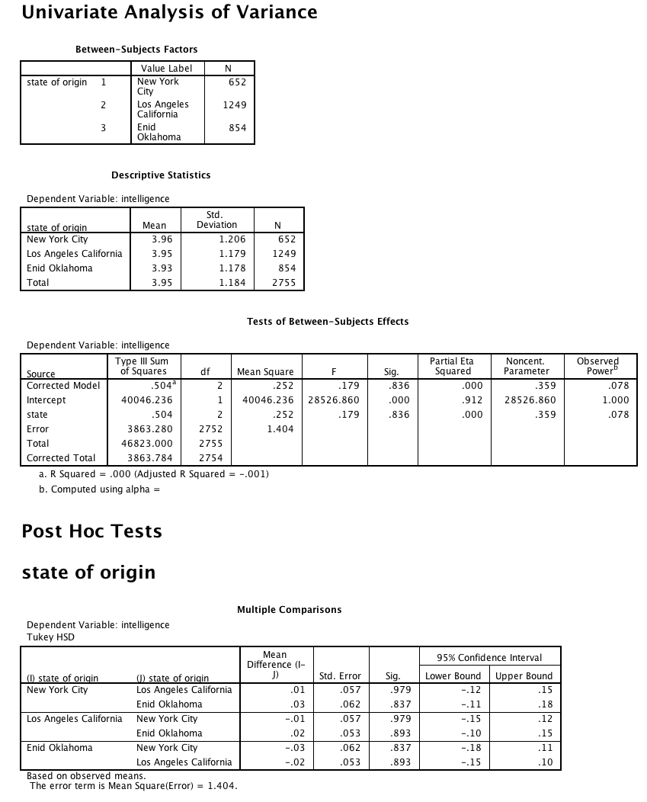
One-Way ANOVA
One-Way ANOVA indicated no significant differences between people from New York City (M = 3.96, SD = 1.21), Los Angeles (M = 3.95, SD = 1.18), and Enid (M = 3.93, SD = 1.18) on intelligence level, F(2,2752) = .18, p = .94, η_{p}² = .00.
Note: η_{p}² is the partial eta squared
Note: Since the F value was not significant, the post hoc analyses do not need to be examined. Notice that none of the pairwise comparisons are significant.

Slide 9
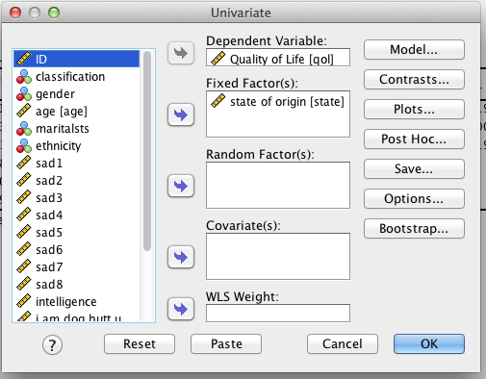
One-Way ANOVA
Move “Quality of Life” into the dependent variable box.
Move the independent variable (in this case “state of origin”) into fixed factors.
Then, repeat the steps above.

Slide 10
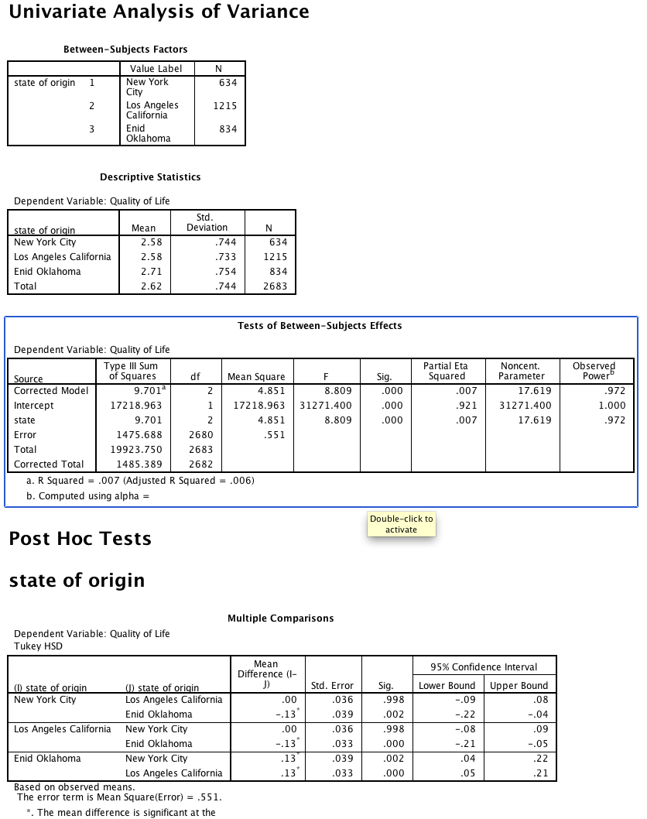
One-Way ANOVA
One-way ANOVA indicated significant differences between people from different states on quality of life, F(2,2680) = 8.81, p < .001, η_{p}² = .007. Specifically, post hoc analyses using Tukey HSD indicated that people from Enid (M = 2.71, SD = 0.75) reported significantly higher quality of life than people from New York City (M = 2.58, SD = 0.74, p = .002) and Los Angeles (M = 2.58, SD = 0.73, p < .001).
Note: Since the F value was significant, the post hoc analyses do need to be examined. The significant levels (i.e., p values) of the pairwise comparisons are where it says “Sig.”.

Slide 11
One-Way ANOVA
One-Way ANOVA examines differences between two or more groups on a dependent variable.
In this example, the One-Way ANOVA option will be conducted.

Slide 12
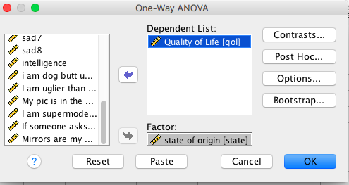
One-Way ANOVA
Move “Quality of Life” into the dependent variable box.
Move the independent variable (in this case “state of origin”) into fixed factors.
Click on “Options”

Slide 13
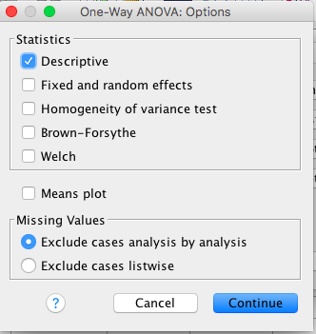
One-Way ANOVA
Under “Options”, click “Descriptive” (which will print means and standard deviations for the IV).
I will generally examine “homogeneity tests” also.
Click “Continue”

Slide 14
One-Way ANOVA
Click on “Post Hoc…”
Since there are more than two groups, a post hoc analysis will need to be conducted if there are significant differences to determine which groups are significantly different.

Slide 15
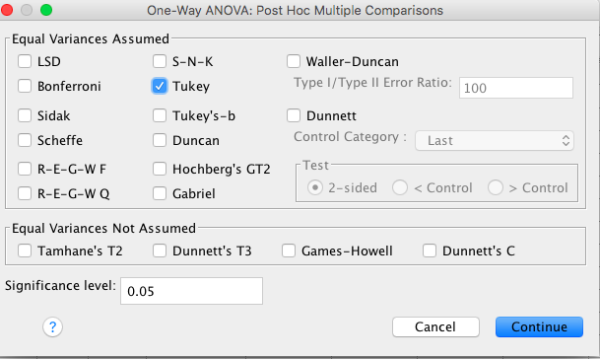
One-Way ANOVA
Click “Tukey”
There are reasons to run the various types of post hoc analyses (but they are not discussed here)
Click “continue”

Slide 16
One-Way ANOVA
Click “OK”.

Slide 17
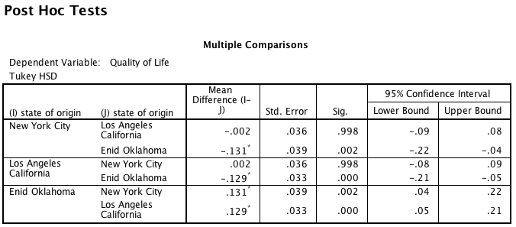
One-Way ANOVA
One-way ANOVA indicated significant differences between people from different states on quality of life, F(2,2680) = 8.81, p < .001. Specifically, post hoc analyses using Tukey HSD indicated that people from Enid (M = 2.71, SD = 0.75) reported significantly higher quality of life than people from New York City (M = 2.58, SD = 0.74, p = .002) and Los Angeles (M = 2.58, SD = 0.73, p < .001).
Note: Since the F value was significant, the post hoc analyses do need to be examined. The significant levels (i.e., p values) of the pairwise comparisons are where it says “Sig.”.

