Slide 1
SPSS
Statistical Package for Social Sciences
Running Frequencies
Department of Psychology
California State University Northridge
www.csun.edu/plunk

Slide 2
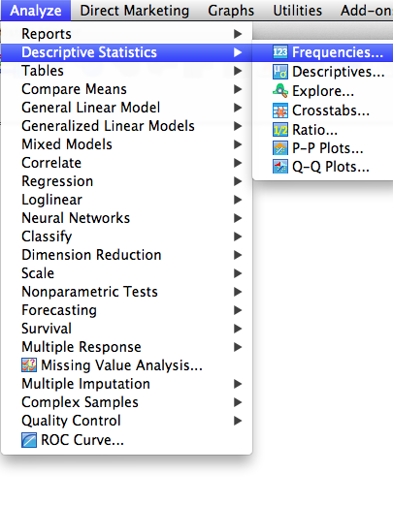
Running Frequencies
Select “Analyze”, then “Descriptive Statistics”, and then “Frequencies”

Slide 3
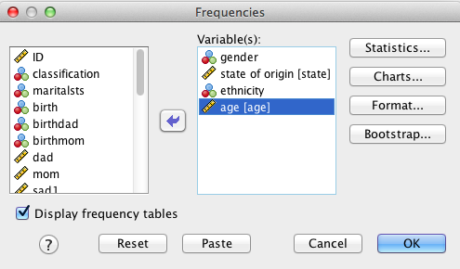
Running Frequencies
Using the sample file from the webpage, move the following variables over to the box on the right: “gender”, “state of origin”, “ethnicity”, and “age”.
Next, click on “Statistics”

Slide 4
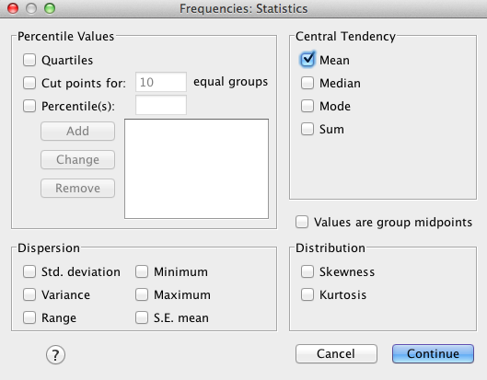
Running Frequencies
This box provides many options for basic statistics.
Select “Mean”
Then click “continue” and then “OK”

Slide 5
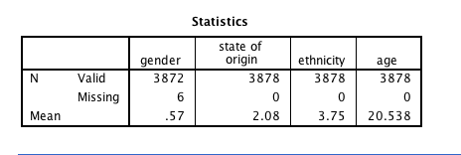
Running Frequencies
The first box in the output demonstrates how many valid and missing cases there are on each variable, as well as the mean.

Slide 6
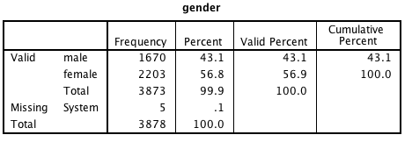
Running Frequencies
The subsequent boxes in the output show the frequency, percent (which would include missing data), valid percent (as if there were no missing data), and cumulative percent

