Slide 1

Automated Additional Pay System
Presented by:
The University Corporation
and
Office of Faculty Affairs

Slide 2
Agenda
Additional Employment Policy
Automated Additional Pay System
How to Use the System

Slide 3
Additional Employment Policy
The CSU Additional Employment Policy (HR 2002-05) and the Unit 3 Faculty Collective Bargaining Agreement (Article 36) establishes a limit to 125% on the total amount of employment an individual may have within the CSU system. Additional employment limitations are based on time-base (FTE), not salary.
Similarly, all other Collective Bargaining Units also limit total workload to 125%.
An employee may be provided with an appointment not to exceed 25% above the 1.0 full-time position.
Employees are limited to no more than 50 hours per week.
For Non-Exempt employees, any hours over 40 must be paid at a rate of time and one half.

Slide 4
The Automated Additional Pay System
Enables us to track the additional employment policy across all areas (State, ExL, TUC).
Replaces current paper process for additional pay
Enables employees to enter their own additional pay and view available time-base (FTE) balance
Requires the system Pre-Authorization for all additional work to be performed

Slide 5
How to Use the System

Slide 6
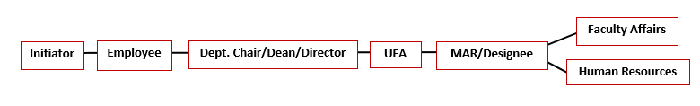


Approval Process
State:
ExL:
TUC:
Email notifications will be sent to each approver
If employee is the initiator, approval will go to next in line
For TUC PI approvals, MARs will be added to the approval path

Slide 7
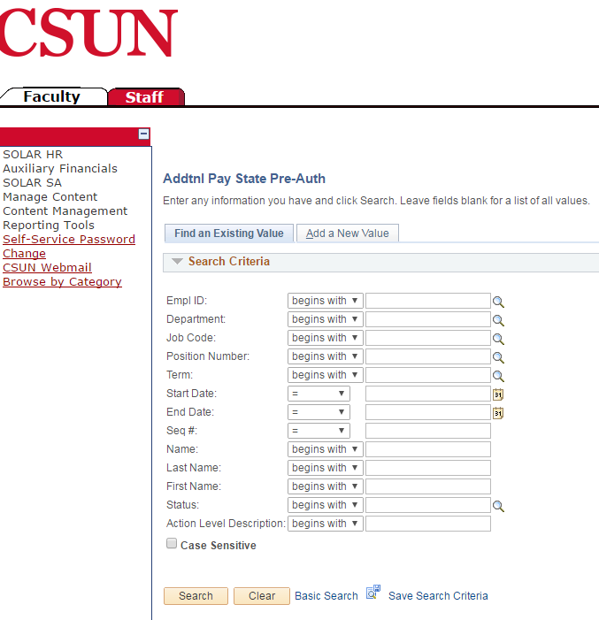
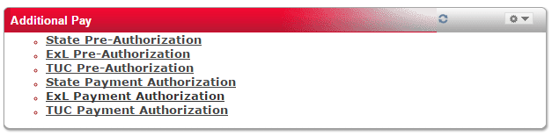
Logging Into the System

Slide 8
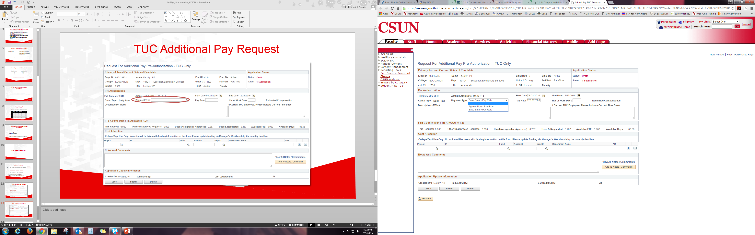
TUC Additional Pay Request

Slide 9
Automated Additional Pay System
goes live
August 1, 2016
for Fall 2016 Semester additional work and beyond

Slide 10
Contacts
Faculty Additional Pay Questions:
Carmen Lichtscheidl – carmenl@csun.edu
TUC Additional Pay Processing Questions:
Georg Jahn – gjahn@csun.edu
Grace Slavik – grace.Slavik@csun.edu

